Slide 1
Loopy
Create music by layering looped recordings of singing, beatboxing, or playing an instrument with a savvy, sophisticated, tactile looper.

Slide 2
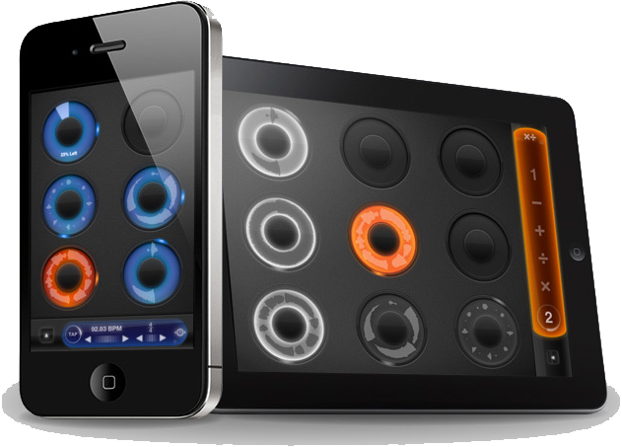
Loopy combines power with simplicity.

Slide 3
Features:
Six, nine or twelvebeautifully rendered loops.
Count-in, count-out, auto-fade, and record chaining, to keep your hands free
Overdub, to construct complex soundscapes from many layers
Merge tracks by dragging one onto another
Tracks of any multiple or fraction of a beat
Audio and visual metronome, in any time signature
Fully trainable MIDI control and MIDI clock send/receive
Import and export loops with your computer via iTunes
Integrated Audio Copy and Paste, and Audiobus support
Imported/pasted loops automatically scaled to fit the beat
Full stereo audio, with per-track pan controls
Live, dynamic tempo controls
Dynamic time shifting: Twist tracks to fix up timing
Full-featured noise gate and expander
Record whole performances with in-app session recording
Share loops and session recordings via SoundCloud, Twitter and Facebook
Live reverse and decay effects for loops
Save and restoresessions

Slide 4
Featured artists:
Dub Fx

Slide 5
Marcdetriumphe

Slide 6
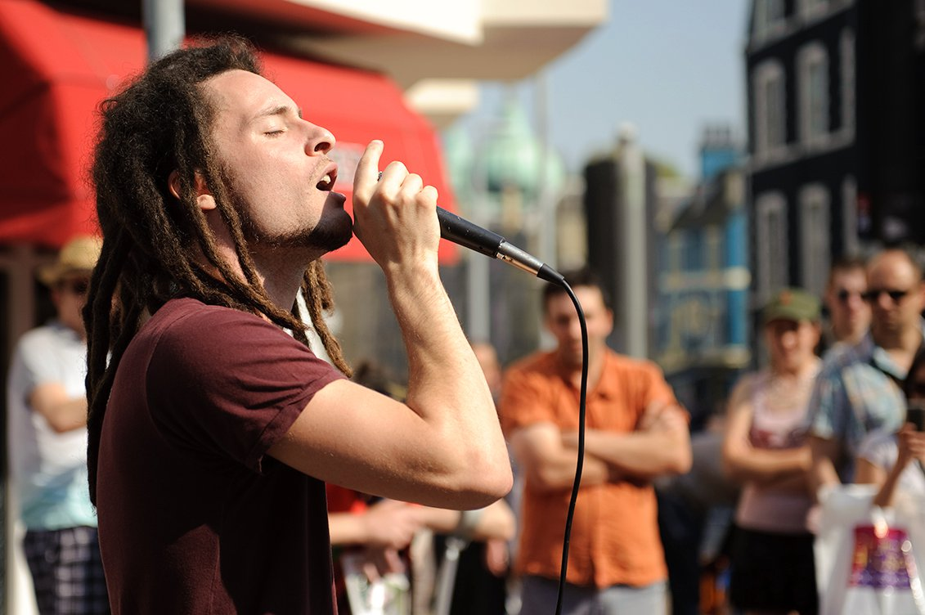
Elijah Mc

