Slide 2
Contents
What is VEVO?
The logo
VEVO TV
Availability
24-hour VEVO record
VEVO certified
FUN FACT

Slide 3
American multinational video hosting service
Founded on December 8, 2009
Joint venture between the "big three" record companies, Universal Music Group (UMG), Sony Music Entertainment (SME) and Warner Music Group (WMG).
VEVO is an abbreviation for video evolution

Slide 4
Vevo's original wordmark, used from December 2009 until March 2013.
Vevo's second logo, used from March 2013 until July 2016.

Slide 5
Vevo launched Vevo TV, internet television channel running 24 hours a day, featuring blocks of music videos and specials. However, the channel was only available to viewers in North America and Germany. Vevo had planned launches in other countries.

Slide 6
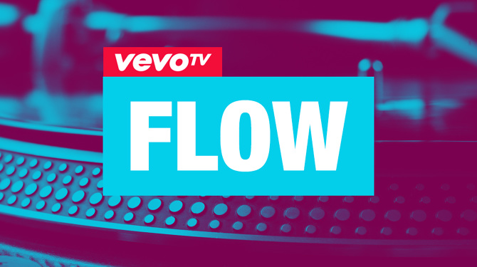
After revamping its website, Vevo TV later branched off into three separate networks: Hits, Flow (hip hop and R&B), and Nashville (country music).

Slide 7
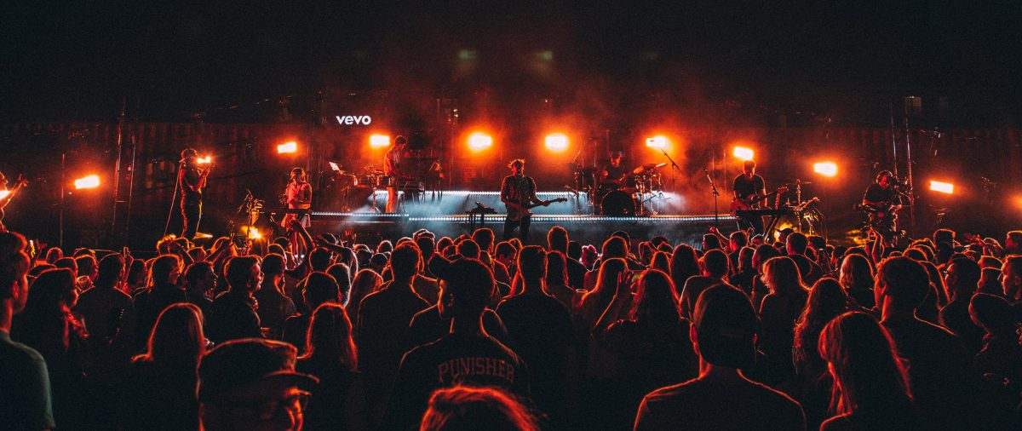
Vevo is available in Australia, Brazil, Canada, France, Germany, Ireland, Italy, Mexico, the Netherlands, New Zealand, Poland, Spain, the United Kingdom, and the United States.

Slide 8
The 24-Hour Vevo Record, commonly referred to as the Vevo Record, is the record for the most views a music video associated with Vevo has received within 24 hours of its release.
The video that currently holds this record is "Look What You Made Me Do" by Taylor Swift with 43.2 million views.

Slide 9
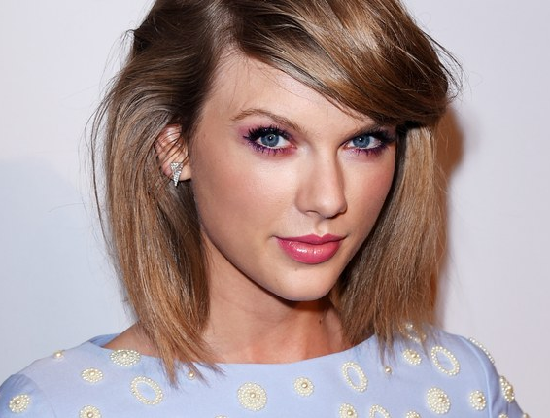
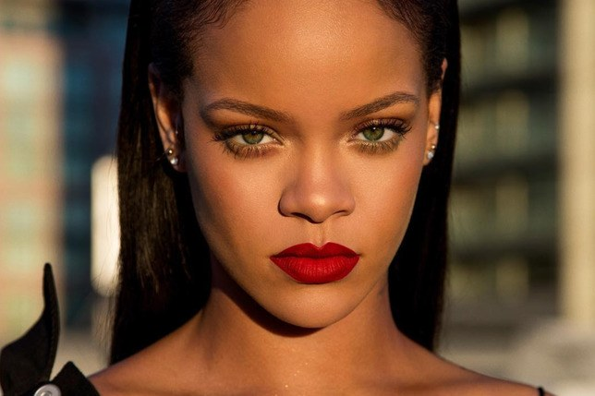
Vevo Certified Award honors artists with over 100 million views on Vevo and its partners (including YouTube) through special features on the Vevo website. It was launched in June 2012.
The Top 5:

Slide 10
In April 2018, Vevo’s YouTube channel got hacked and caused the deletion of many videos including the most viewed YouTube video of a song called Despacito by Luis Fonsi.

Slide 11
THE END

