Slide 1
Legends from Tarnów
Autor: Maciej Wilczyński

Slide 2
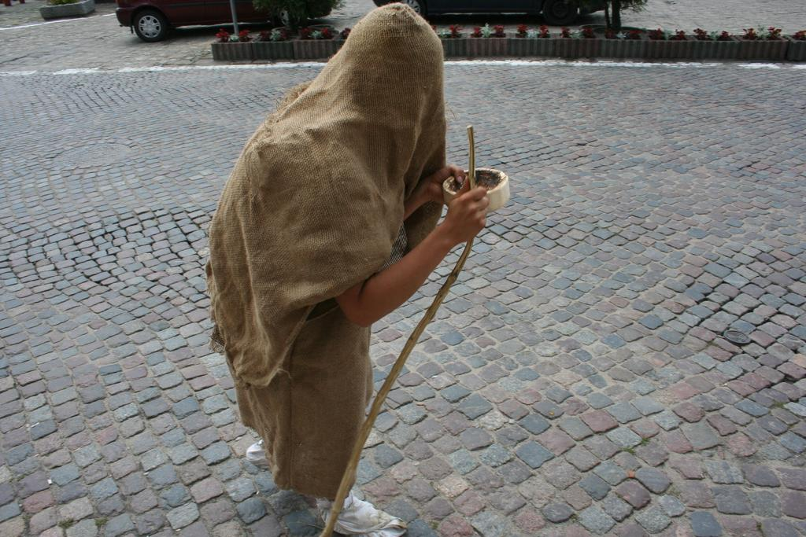
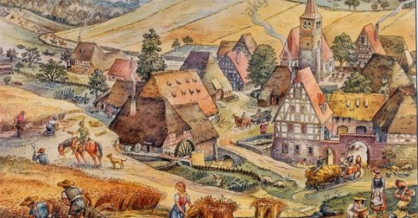
Legend about sign of Tarnów
When Poland had so many problems like war and starving, little boy Boromir decided to go to Tarnów

Slide 3
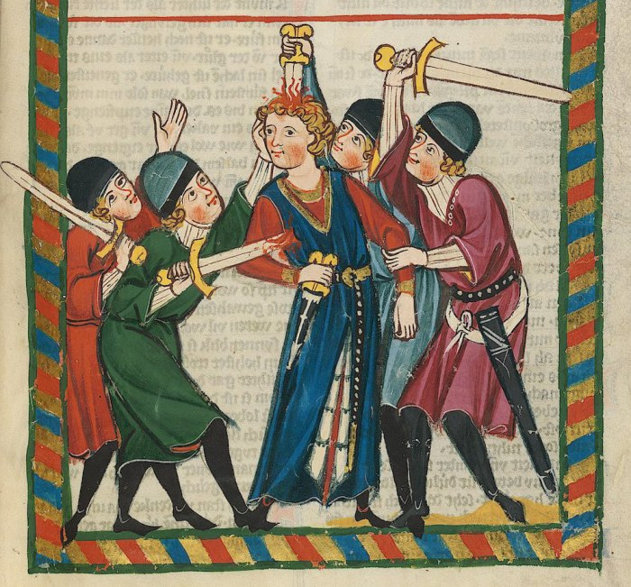
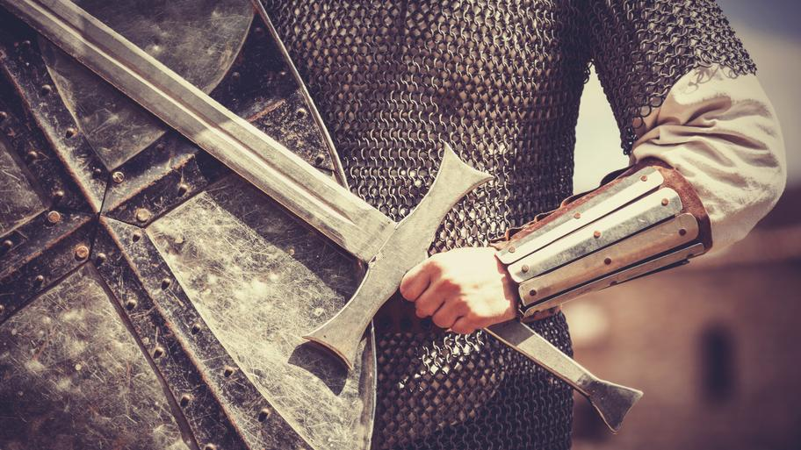
After many years when he worked as a help of shoes maker, he decided to be a knight. But he couldn’t be because he was still to little and not strong enough.

Slide 4
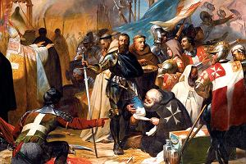
One day when he walked around the city, he saw knights who was bullying the elderly man. Boromir was good pearson so he helped the older man. Gaffer gave him an adress.

Slide 5
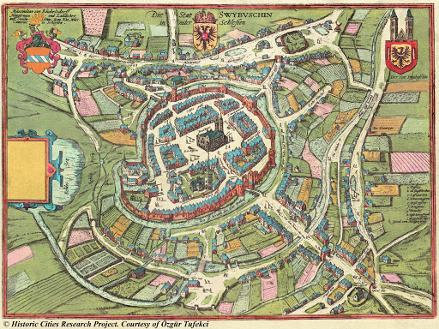
Boromir gone to see the adress which elderly man gave him. He found door of cristal but he could’t open it. On paper he read that only sombody of good heart and smart can open it. He tried but he decided to try again at night.

Slide 6
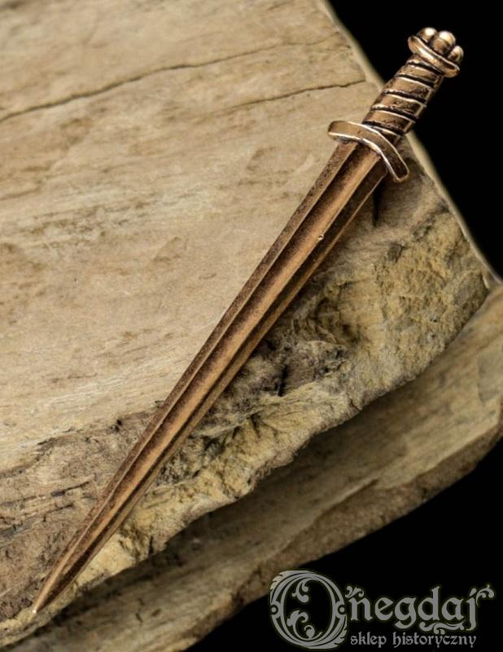
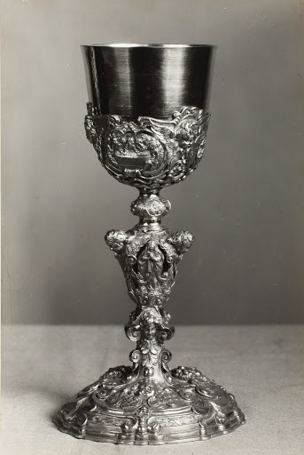
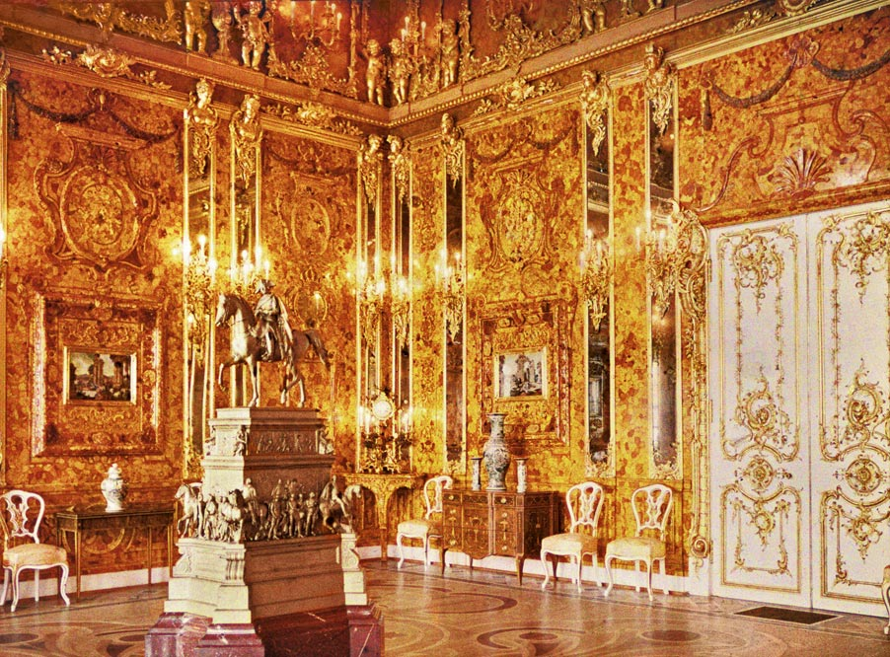
When Boromir opened the door, he saw awesome and gold chamber. In the middle of this room lied the bronze sword, silver chalice and gold medallion with star and moon. Boromir was suprised. Then he heard the voice: “choose only one”

Slide 7
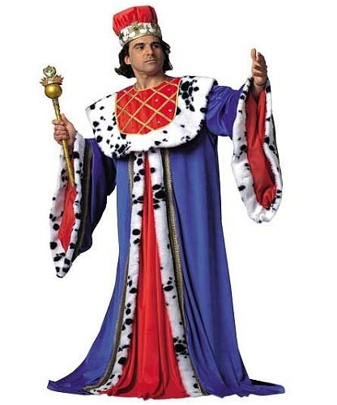
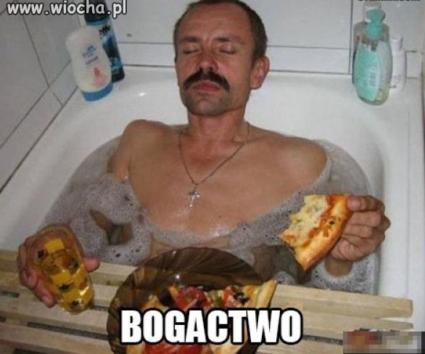
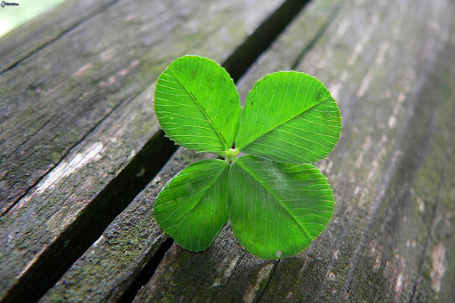
After this voice appered the erlderly men. He explained that if boy choose the sword he get the kingdom. If he choose silver cup, he will be rich and he never die due to lack of water. Elderly man told him that if he choose the medalion he get the happiess and he will be safe.

Slide 8
Boromir couldn’t take one of this thig. Elderly ask him to bring blue material. Boromir was looking for this blue textil. During his reserch he saw the execution of young girl. He thought that the power is very cruel. After that he saw the rich men who was with security. And he thought that money are good but they don’t give safety.
Finally Boromir found the blue material.He gave him to elderly and remember what he saw during the journey he choosen the medallion. Elderly congratulated Boromir good choice and give him blue material.

Slide 9
Having happines, Boromin went to find his mother.But on his road he met the robbers who killed Boromir because he didn’t want give them his neacklet. When he died, the moon and star fell down on blue material and since then the sign of Tarnów is moon and star on blue background.

