Slide 1
MUSIXMATCH
Explore the world's largest catalog of song lyrics and translations

Slide 2
MUSIXMATCH
Active Users: Over 50 million
Number of Lyrics: Over 14 million
Supported languages: 58
Licensing: Worldwide agreements with Sony/ATV-EMI,Warner Chappell, Universal Music Publishing Group, BMG Chrysalis, Kobalt Publishing, Spirit Music Publishing, Harry Fox Agency, PeerMusic, Walt Disney Publishing, among several others.
Platforms: Web, iOS, Android, Chrome
Employees: 30
Musixmatch’s lyrics catalogue is created, synched, and translated by millions of contributors from the Musixmatch community. The final version of the lyrics is edited and validated by a team of international curators. Users can connect Musixmatch with Spotify, Apple Music, and dozens of other music services to enjoy lyrics synchronized to the music.

Slide 3
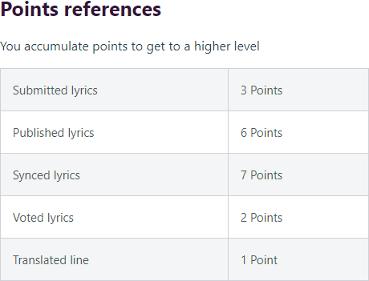
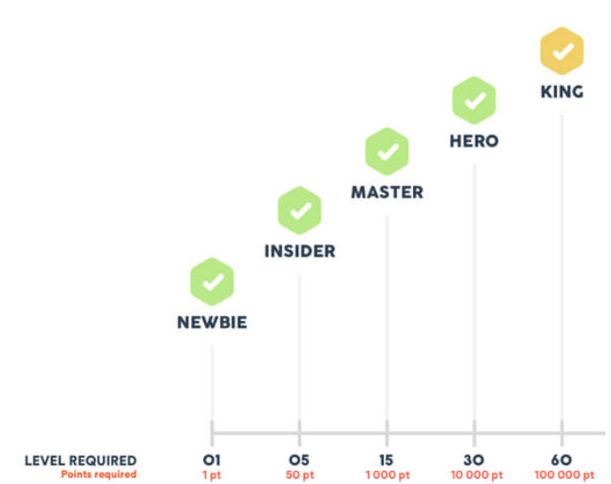
Our global community of contributors is what makes Musixmatch special. The contributors make possible to give everyone in the world access to the universe of lyrics and create the best possible Musixmatch experience by adding, editing, synchronizing and translating lyrics.
But Musixmatch is also a challenge - our contributors earn points for all their hard work.
Some users are picked by the Musixmatch staff and given the Curator status, that give them extra powers to control what’s happening in the community.

Slide 4
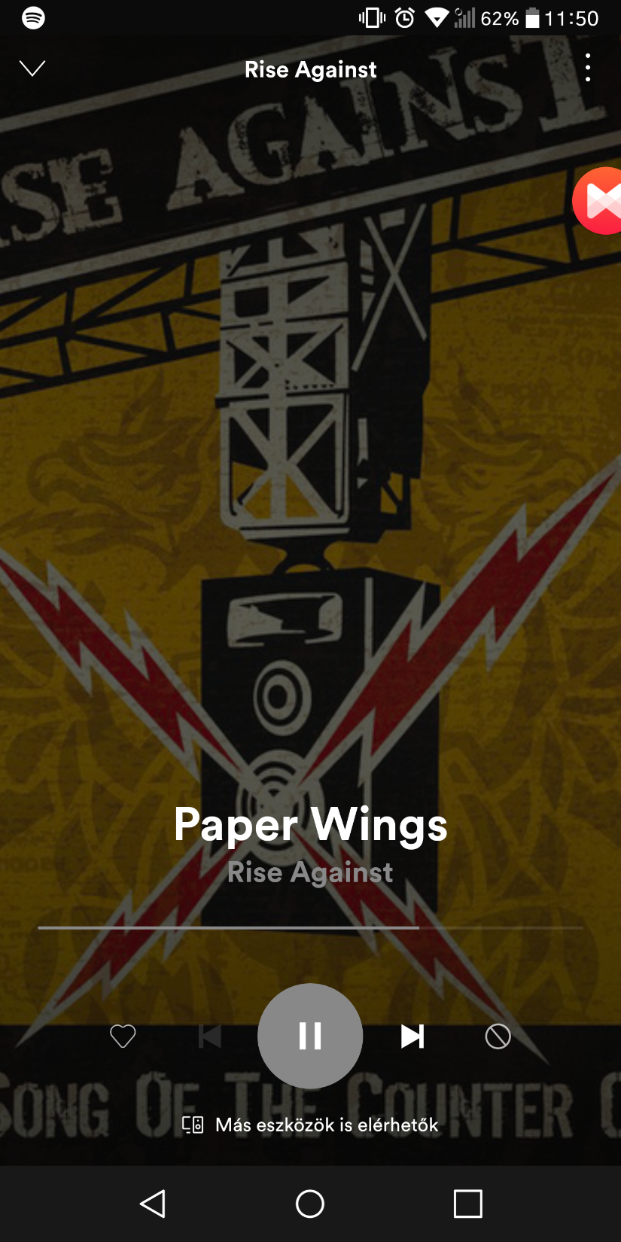
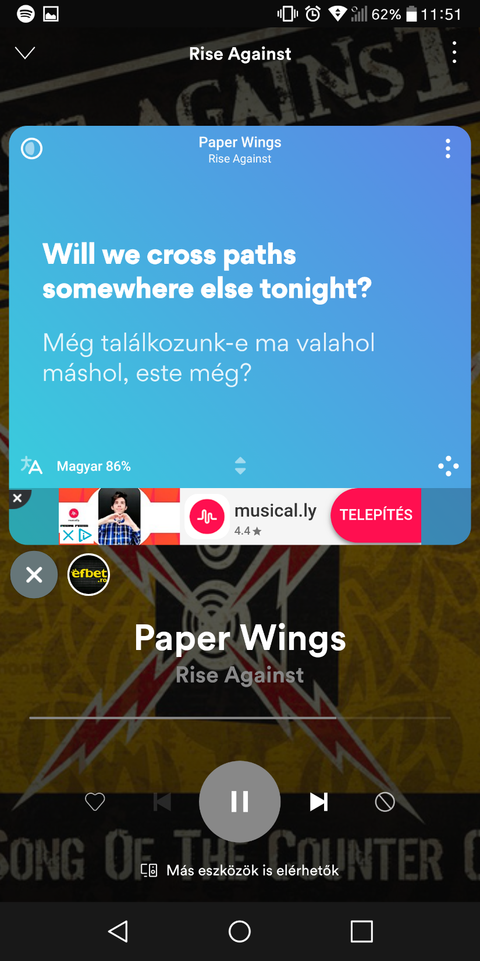
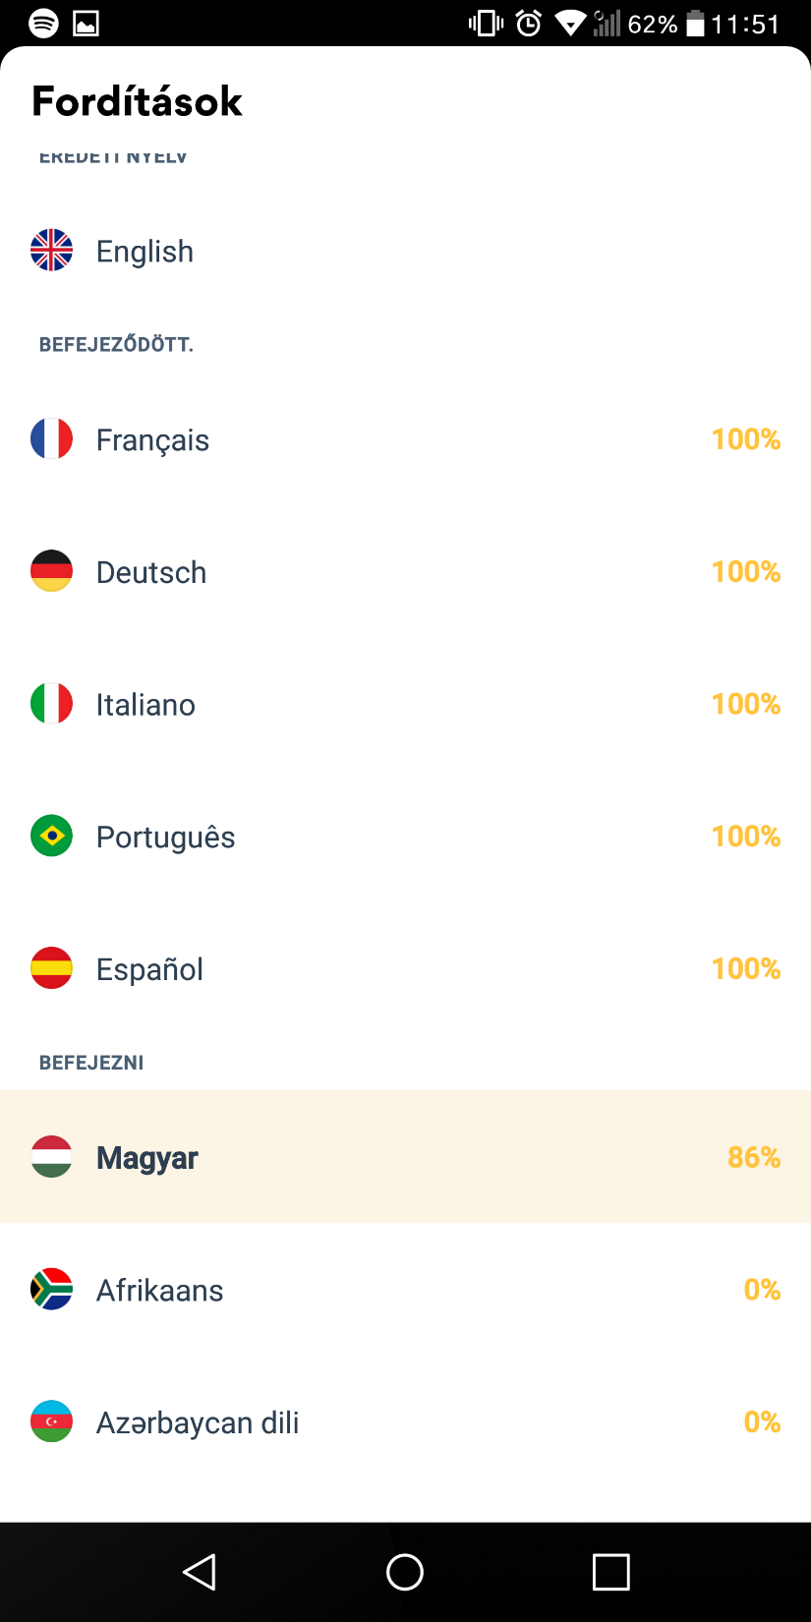
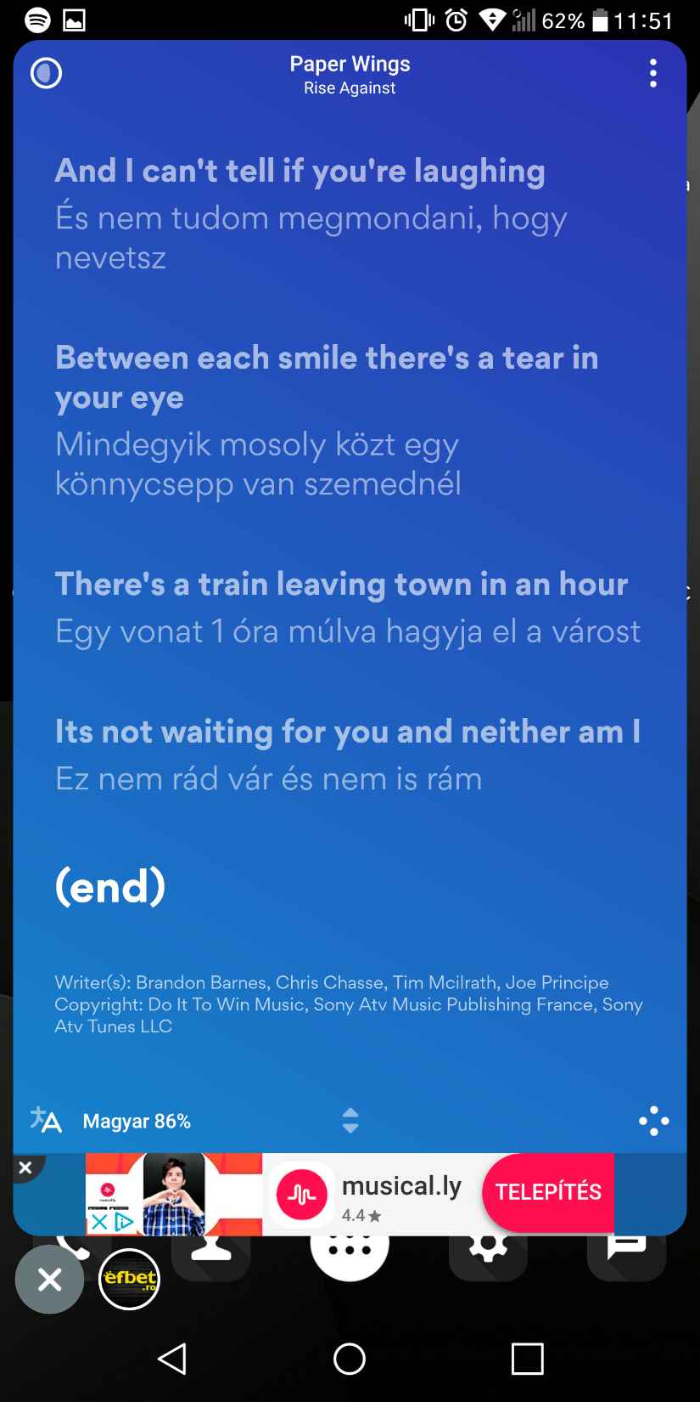
FloatingLyrics
if you
pushtheicon
Translations
cost
misable
Musixmatch can identify songs. You can change between the translations, or turn them off. Your also able to save your songs.

Slide 5
SOURCES
https://www.musixmatch.com/

