Slide 2
Short facts
Swedish entertainment company
Available in most of Europe, most of the Americas, Australia, New Zealand, and parts of Asia.
Pays royalties based on the number of artists' streams as a proportion of total songs streamed

Slide 3
Benefits
Spotify offers free and paid membership
On Spotify Premium you can listen to the music when you are offline, access to more than 30 million songs, travel to other countries with the music you love, an ad-free experience, play Spotify through your TV or car
different membership plans ($9.99(regular); $14.99(for family); $4.99(for students) per month)

Slide 4
There is a free trial for one-month
Suitable for various devices (iPhone or Android or web browser)
Simple to use

Slide 5
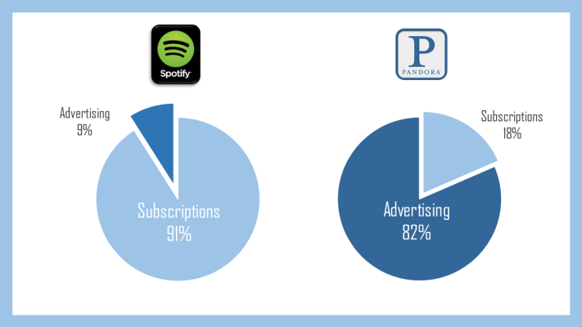

Slide 6
Disadvantages
Spotify had its own lyrics feature, but they decided to remove it
Available in a limited number of countries

Slide 7
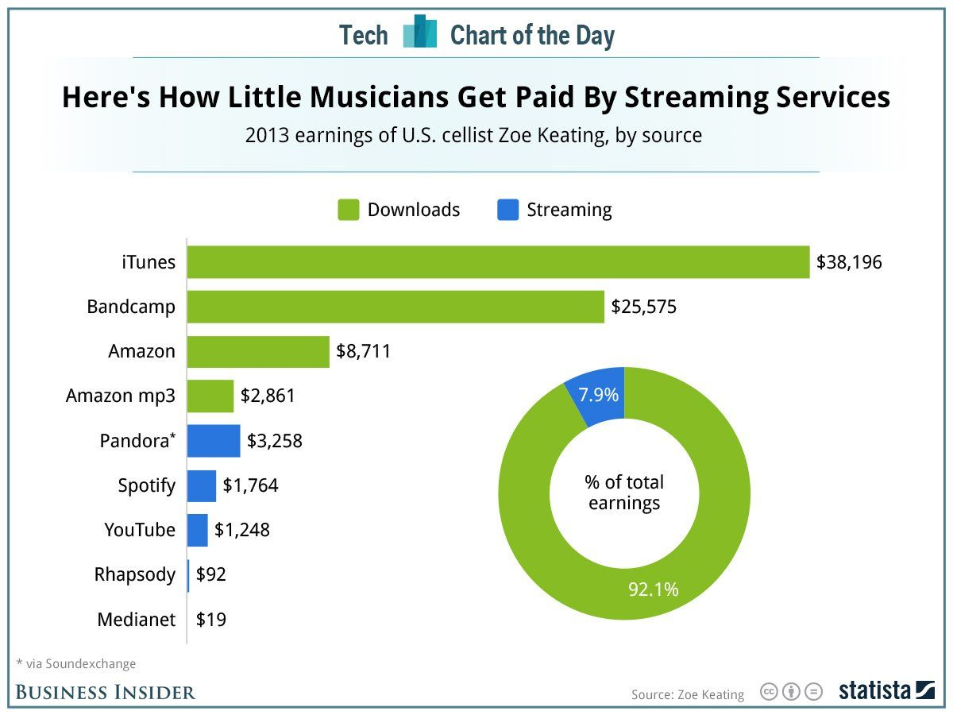

Slide 8
Spotify premium

Slide 9
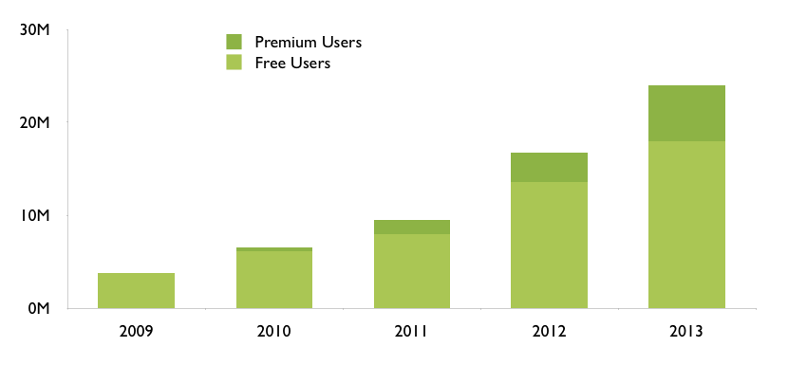

Slide 10
Comparison with Apple music

Slide 11
Statistics
159 million active users
71 million paid subscribers
30 million songs
20,000 songs added per day
2 billion playlists
5 million playlists created or edited per day
Reported value is $19 billion

Slide 12
References
https://www.technobezz.com/advantages-and-disadvantages-of-spotify/
https://expandedramblings.com/index.php/spotify-statistics/
https://en.wikipedia.org/wiki/Spotify

