Slide 1
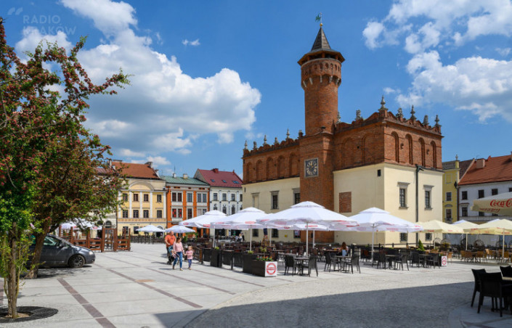
CURIOSITIES ABOUT TARNÓW

Slide 2
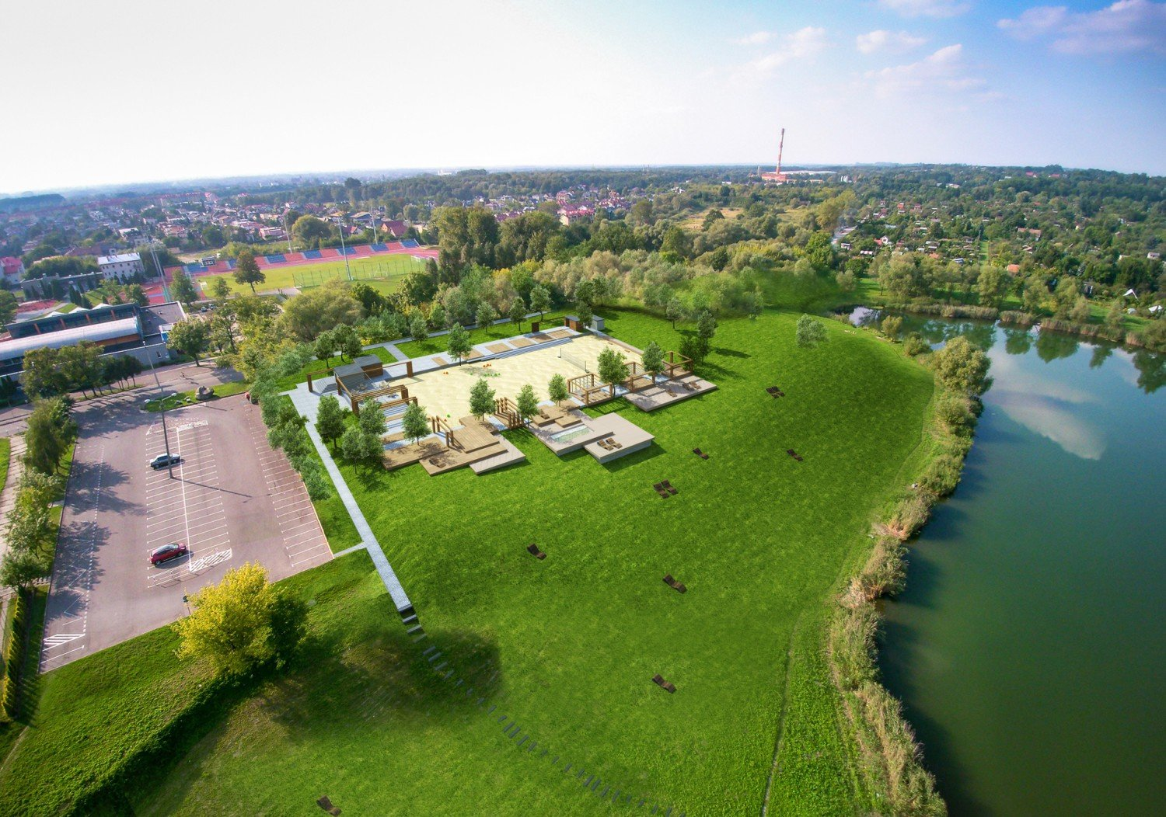
TARNÓW POLISH HEAT POLE
Tarnów has been recognized as the "Polish heat pole". This has been scientifically proven. Three parameters were analyzed and in each of them Tarnów took the lead: the longest growing season, the highest average annual temperature and the longest thermal summer.

Slide 3
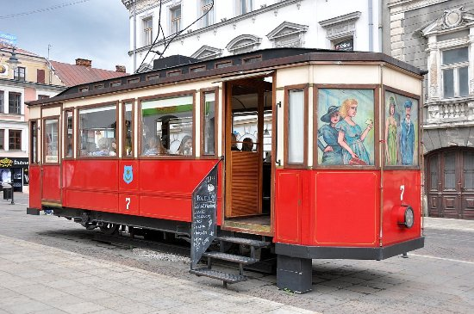
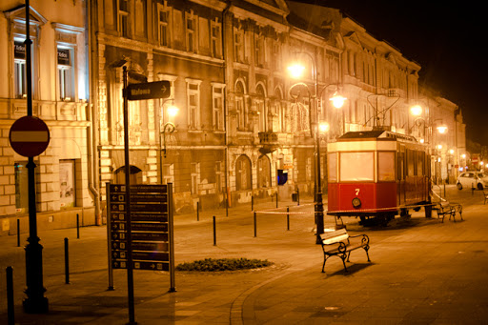
CAFE TRAMWAJ
An electric tram appeared in Tarnów in 1911. Only one line was built. Initially, this type of communication in Tarnów was successful. The collapse of tram transport began to bring large financial losses. Ultimately, the traction network in Tarnów was dismantled during the German occupation in 1942. Eight carriages from Tarnów went to the rails in Lviv, where they were used until the 1970s. One copy of the Sanok SW1 tram from Tarnów has survived to this day in the Lviv depot. In Tarnów, for several years, there has been a copy of a tram turned into a cafe.

Slide 4
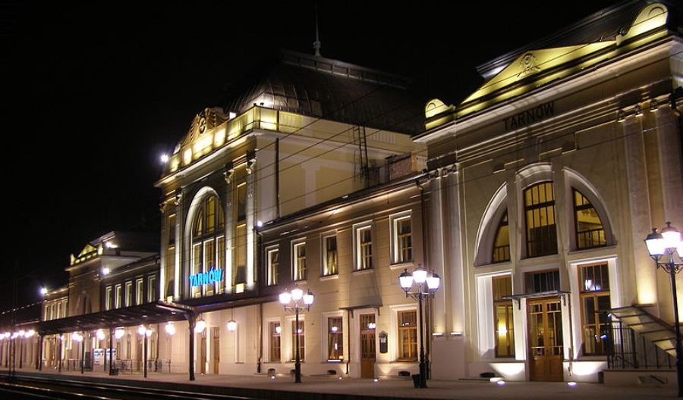
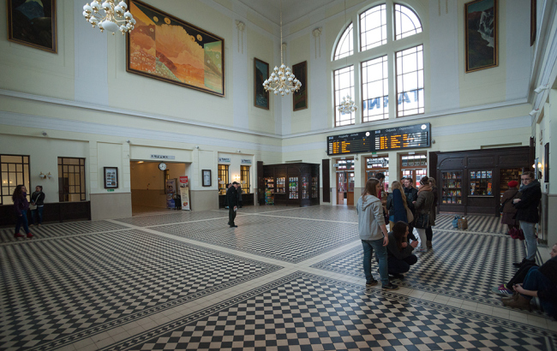
MOST BEAUTIFUL MAIN TRAIN STATION IN POLAND
Tarnów has the most beautiful railway station in Poland. This was the decision of Internet users who cast their votes in the competition announced by PKP.

