Slide 2
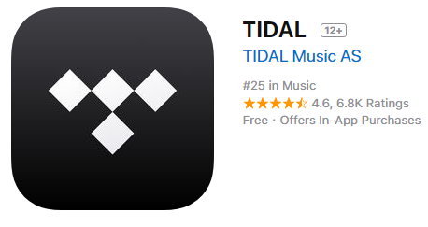
WHAT IS THIS?
Tidal started in early 2015, as a descendant of WiMP combined with the strength of Jay-Z - an American rapper, multimillionaire and businessman. At the time of the uprising, the service tried to prove that it is created by artists who receive remuneration. It was a rebellion against the free version of Spotify, where it is enough to listen to commercials to have access to the entire music collection. For an ordinary user Tidal is primarily a music service, very similar to the already known Spotify, or Deezer, or Apple Music.

Slide 3
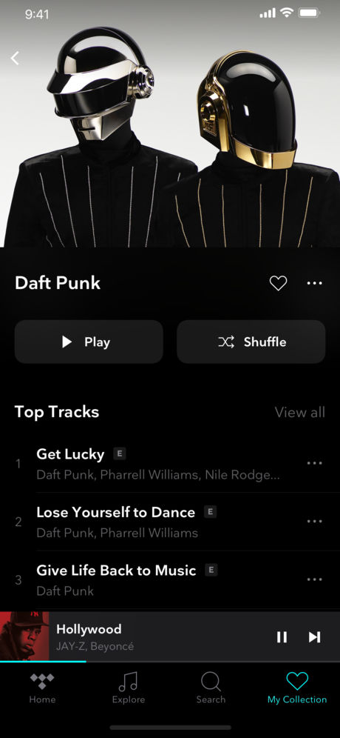
FEATURES
40 million songs
TIDAL has over 40 million songs in our catalog and over 130,000 high quality videos, offering passionate music fans both a premium and high fidelity CD sound quality, along with high resolution video.
Favorites Build your personal music collection simply by marking albums, artists, tracks and playlists as your favorite.
Stories behind the music Read our integrated music articles, features and interviews.

Slide 4
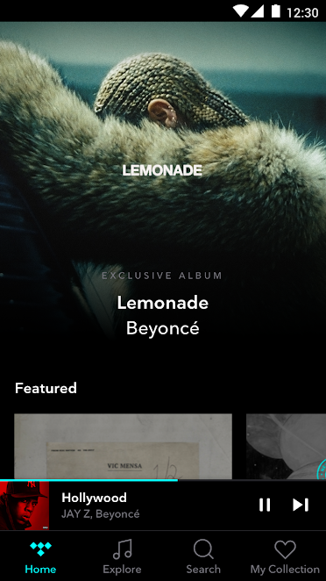
Network Players
TIDAL works on a wide array of network players, enabling hassle-free setup and high quality streaming on brands such as Sonos, Naim, Linn, Oppo, Denon, Bluesound, Devialet, Meridian, Harman Kardon, Burmester, Squeezebox and many others.
Offline
With a simple swipe you can take your music offline, which allows you to continue to listen to your favorite music on TIDAL even when you're not connected to the internet or a mobile network.

Slide 5
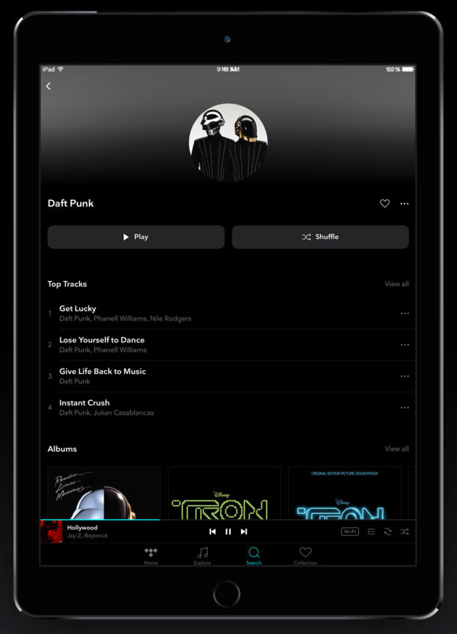
Import playlists
Import your playlists from other streaming services directly to TIDAL through third-party site Soundiiz.com
Curated content. Playlists, articles and interviews
TIDAL has a world class editorial team regularly delivering articles and interviews across all genres that deliver intimate and revealing looks into your favorite artists, as well as artists you may end up reading about for the very first time.

Slide 6
Supported plaforms:

Slide 7
PREMIUM OR HiFi?
TIDAL comes in two variations, the difference comes down to sound quality
HiFi
Utilizing the file formats FLAC and ALAC with a bitrate of 1411Kbps,.
$19.99
Premium
With its higher than industry-average bitrate, Premium streams in 320Kbps using the file format AAC.
$9.99

Slide 8
Ratings

