Slide 1
The Wilberforce – Huxley debate

Slide 2
The 1860 Oxford evolution debate took place at the Oxford University Museum in Oxford, England, on 30th of June in 1860, seven months after the publication of Charles Darwin's On the Origin of Species.

Slide 3
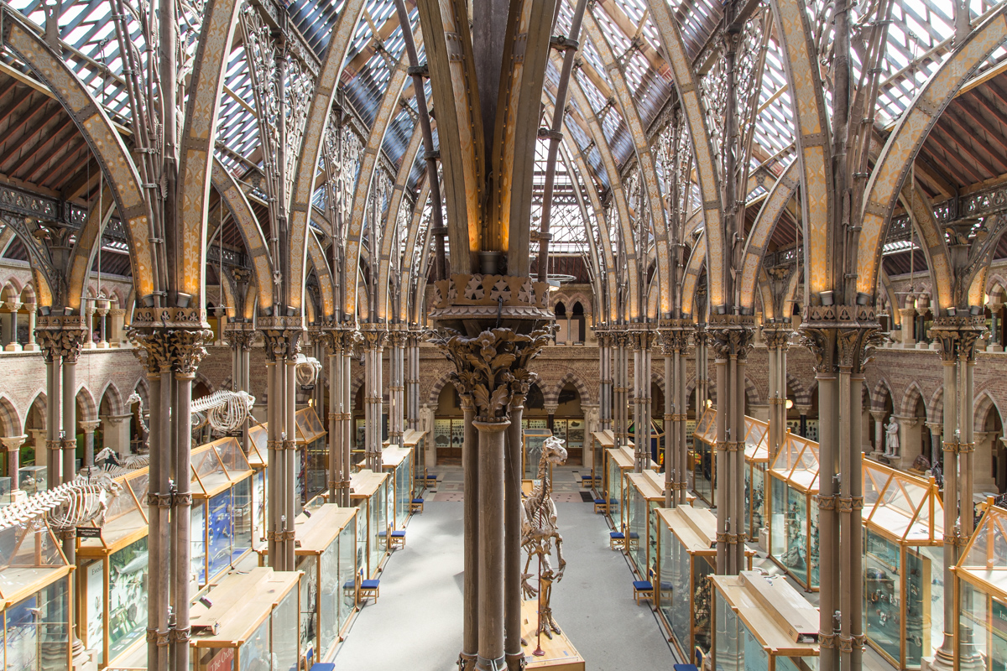

Slide 4
Controversy
The idea of transmutation of species was very controversial in the first half of the nineteenth century, seen as contrary to religious orthodoxy and a threat to the social order, but welcomed by Radicals seeking to widen democracy and overturn the aristocratic hierarchy. The scientific community was also wary, lacking a mechanistic theory.

Slide 5
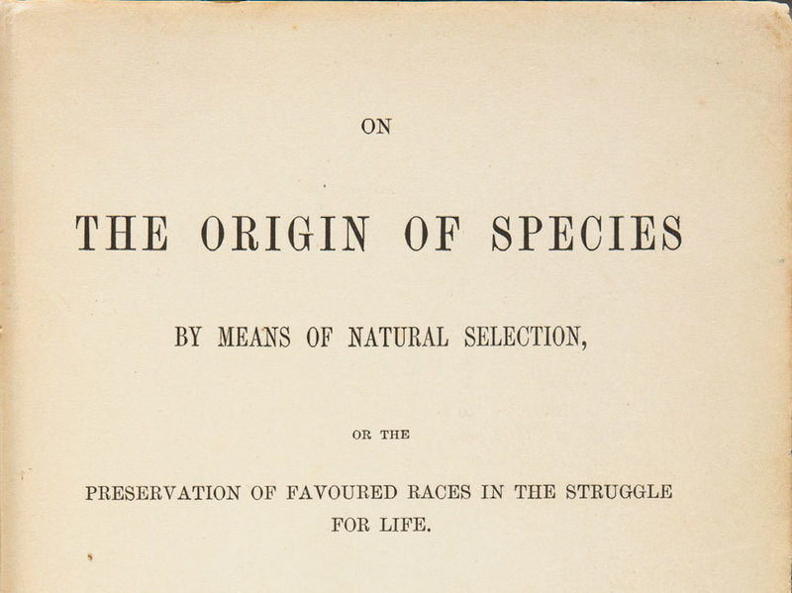
The debate was focused on:

Slide 6
Several prominent British scientists and philosophers participated, including Thomas Henry Huxley, Bishop Samuel Wilberforce, Benjamin Brodie, Joseph Dalton Hooker and Robert FitzRoy.

Slide 8
Word spread that bishop Wilberforce would speak against Darwin's theory at the meeting on Saturday, 30th of June in 1860. Wilberforce was one of the greatest public speakers of his day and, according to Bryson, "more than a thousand people crowded into the chamber; hundreds more were turned away." Darwin himself was too sick to attend.

Slide 9
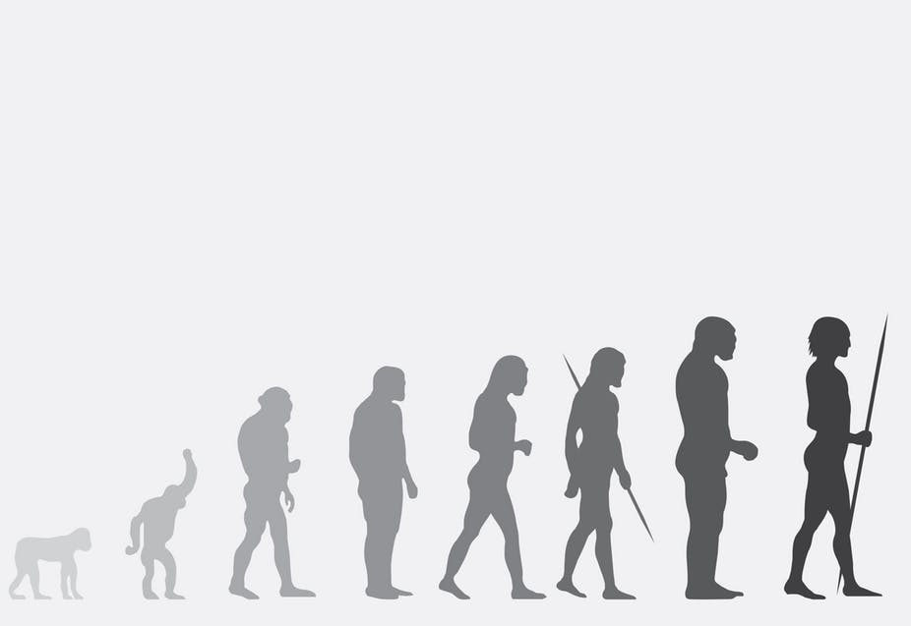
Wilberforce criticised Darwin's theory on ostensibly scientific grounds, arguing that it was not supported by the facts, and he noted that the greatest names in science were opposed to the theory.

Slide 10
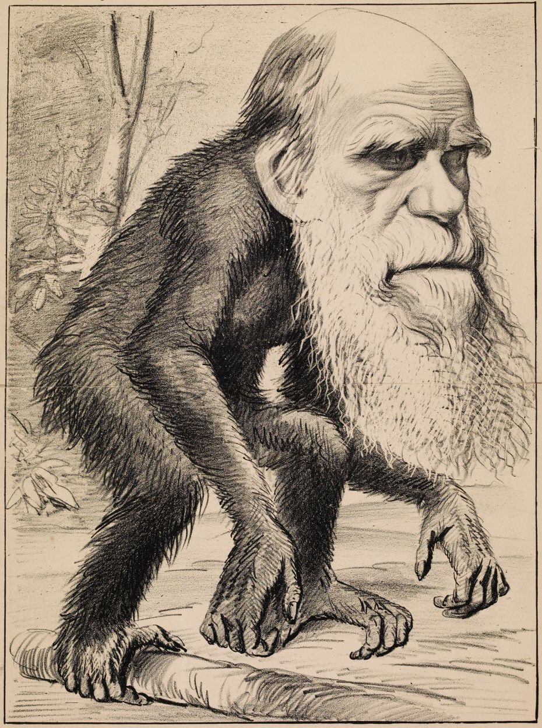
The debate is best remembered today for a heated exchange in which Wilberforce supposedly asked Huxley whether it was through his grandfather or his grandmother that he claimed his descent from a monkey.

Slide 11
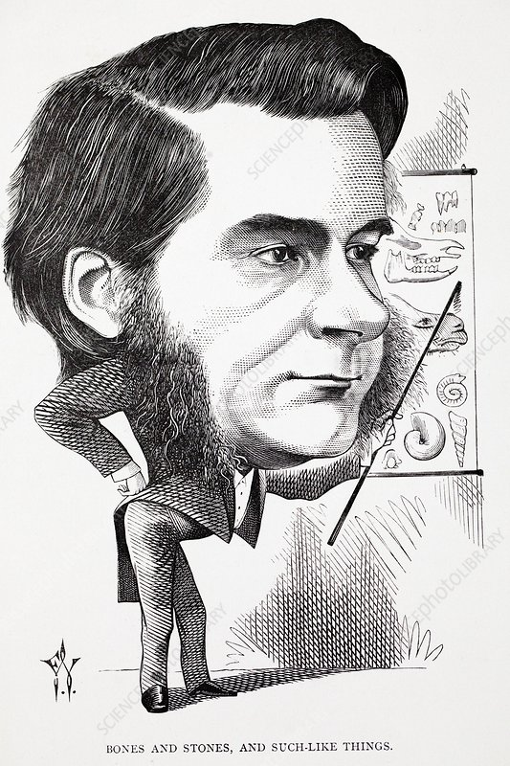
Huxley is said to have replied that he would not be ashamed to have a monkey for his ancestor, but he would be ashamed to be connected with a man who used his great gifts to obscure the truth.

Slide 12
No actual documentation
Although Huxley and Wilberforce were not the only participants in the discussion, they were reported to be the two dominant parties. However, no actual verbatim account of the debate exists. There is considerable uncertainty regarding what Huxley and Wilberforce actually said, and subsequent accounts were subject to distortion.

Slide 13
No winners?
Notably, all three major participants of the discussion felt they had had the best of the debate. Wilberforce wrote that, "On Saturday Professor Henslow called on me by name to address the Section on Darwin's theory. So I could not escape and had quite a long fight with Huxley. I think I thoroughly beat him." Huxley claimed "[I was] the most popular man in Oxford for a full four & twenty hours afterwards." Hooker wrote that "I have been congratulated and thanked by the blackest coats and whitest stocks in Oxford." Wilberforce and Darwin remained on good terms after the debate.

Slide 14
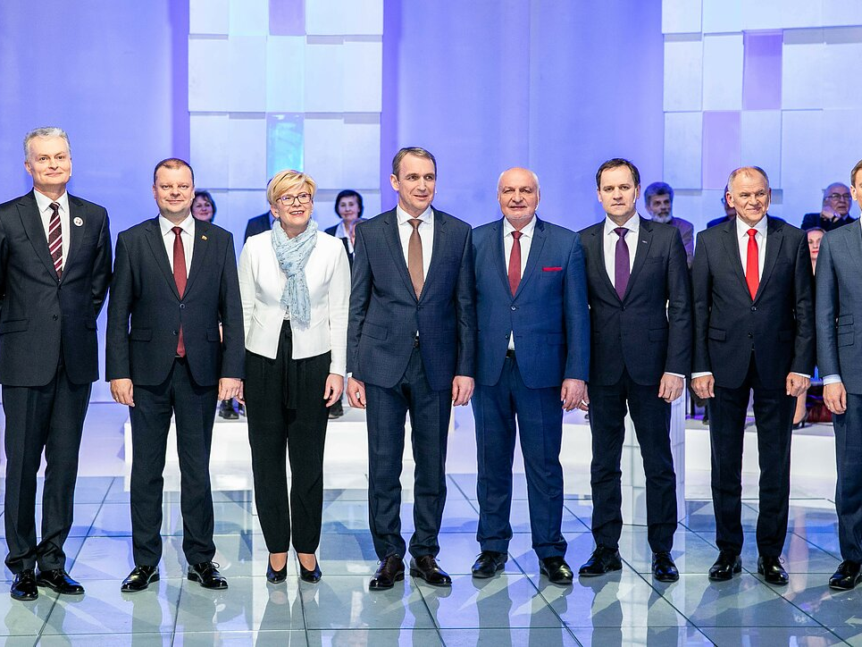
Just this year, there were many presidential rallies and debates in our country.

Slide 15
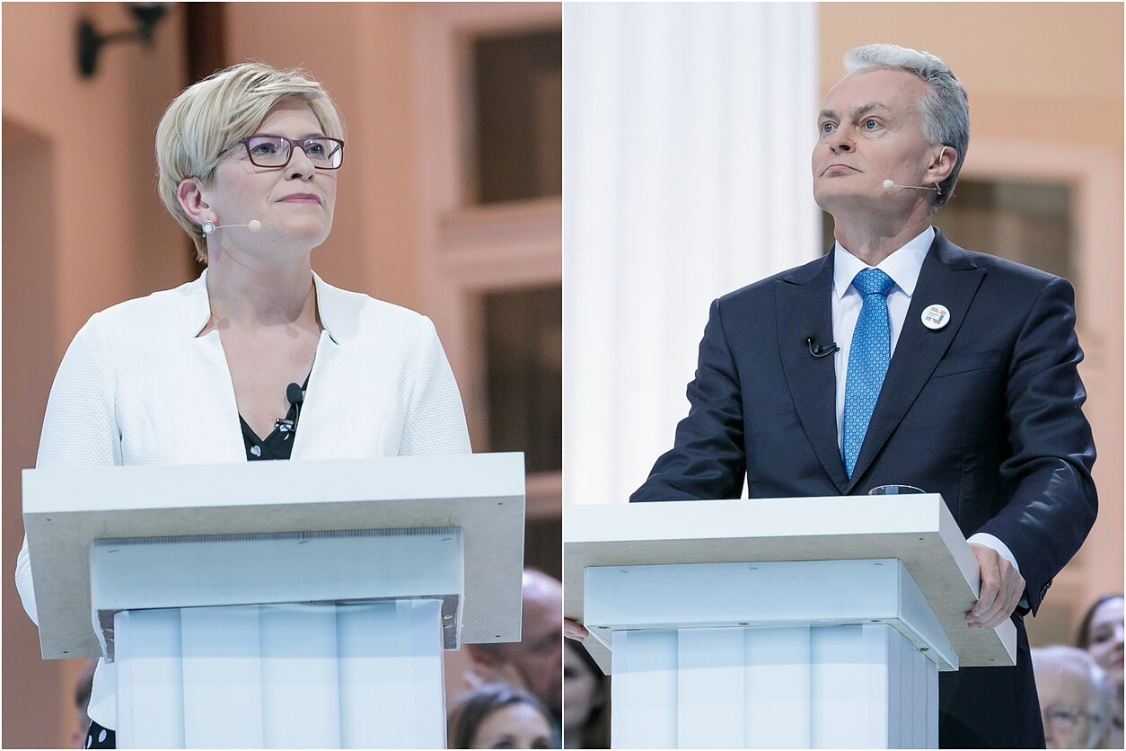
The most prominent presidential debate - the Vilnius debate between two candidates with most supporters: G. Nausėda and I. Šimonytė.

Slide 16
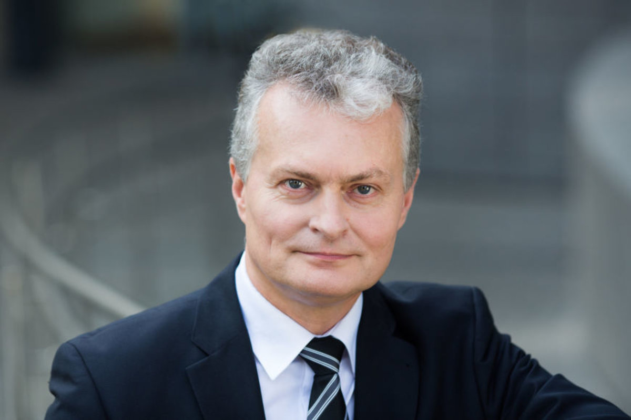
After the mentioned debate, the last voting tour took place and Lithuania elected its new president – G. Nausėda.

