Slide 1
Natural Heritage
Poland

Slide 2
What exactly is Natural Heritage?
Definiton
Natural Heritage refers to natural features, geological and physiographical formations and delineated areas that constitute the habitat of threatened species of animals and plants and natural sites of value from the point of view of science, conservation or natural beauty.
Source: UNESCO Institute for Statistics, 2009 UNESCO Framework for Cultural Statistics and UNESCO, Convention Concerning the Protection of the World Cultural and Natural Heritage, 1972.

Slide 3
So what does Natural Heritage really include?
Countrysides
Natural Environment (biodiversity, geodiversity)
Cultural Landscapes (natural features that may have cultural attributes)
Private and publicly protected natural areas
Zoos, aquaria and botanical gardens
Natural habitat, Marine Ecosystems, Sanctuaries, Reservoirs etc.

Slide 4
Examples in Poland

Slide 5
Białowieża Forest (Puszcza Białowieska)

Slide 6
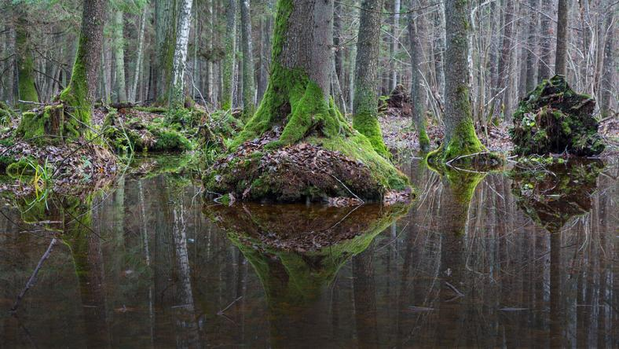

Slide 7
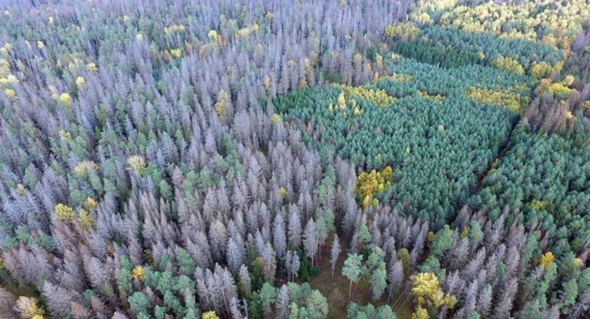

Slide 8
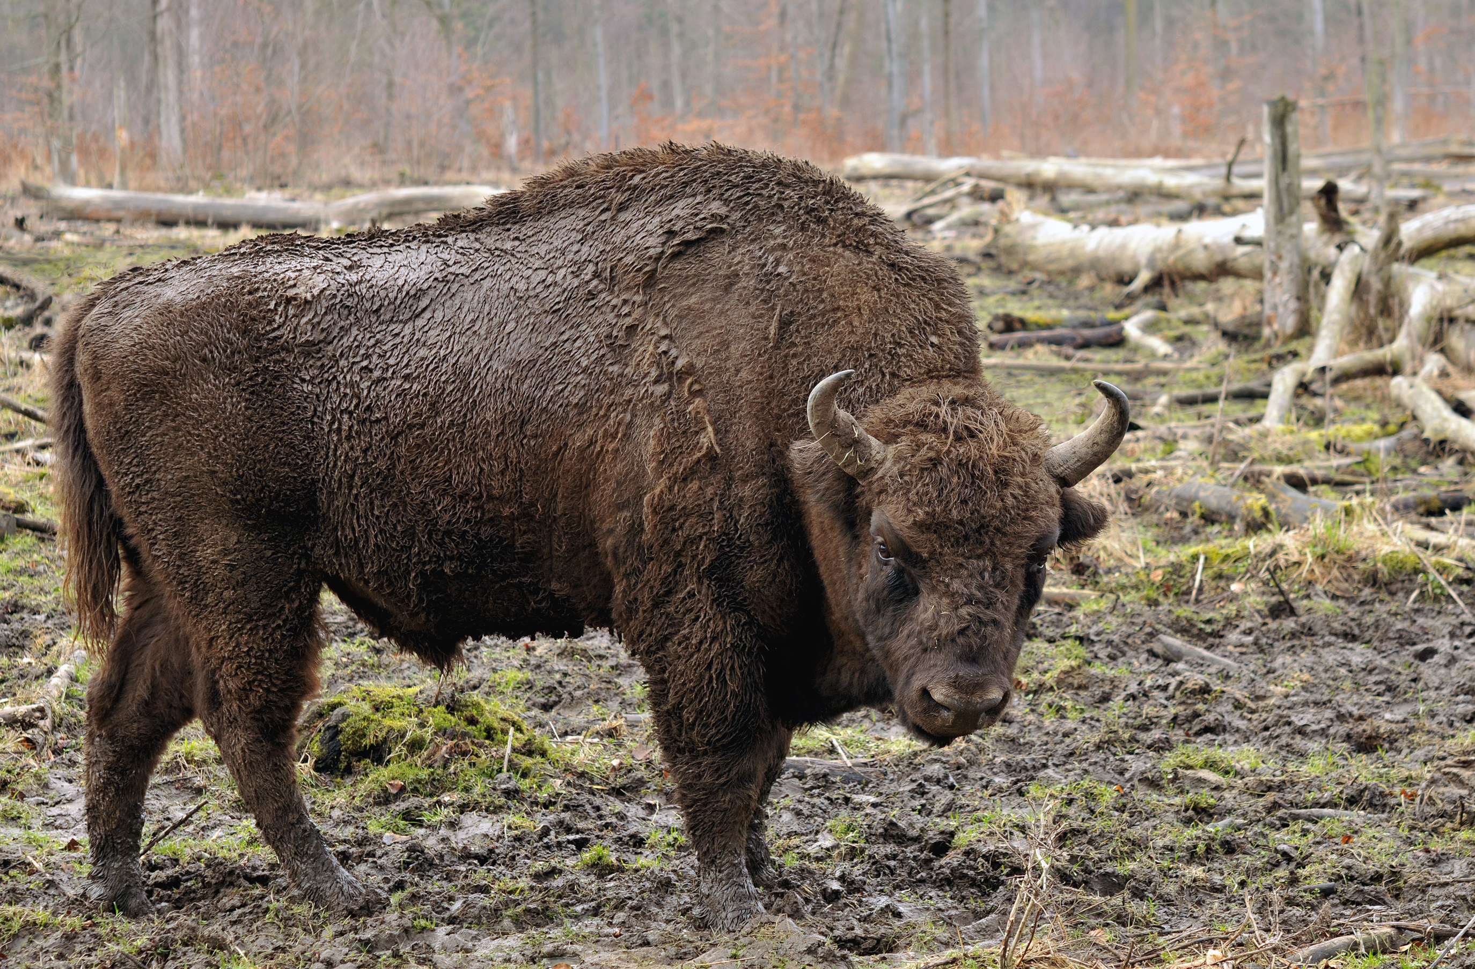

Slide 9
Stołowe Mountains (Góry Stołowe)

Slide 10
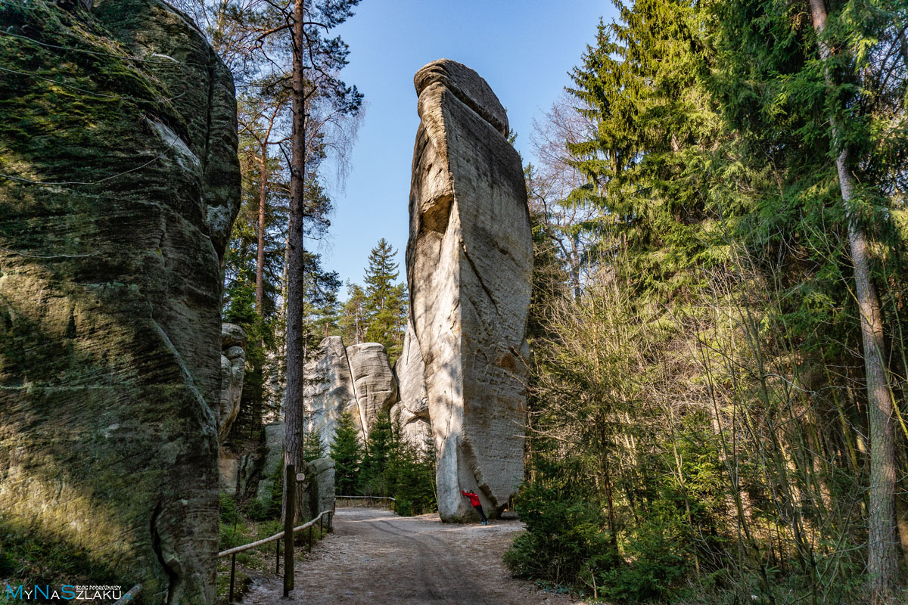

Slide 11
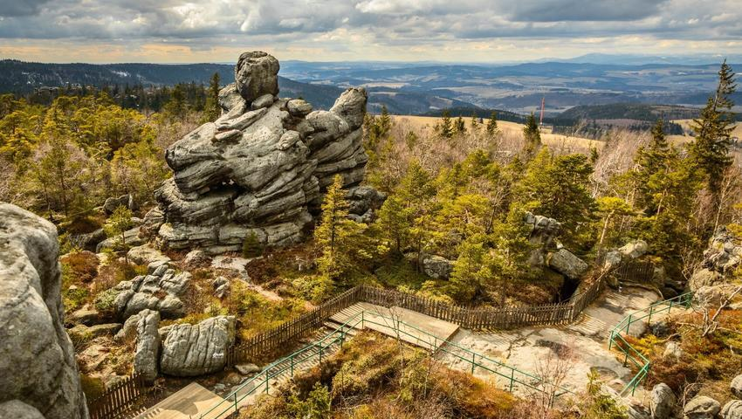

Slide 12
Dąb Bartek

Slide 13
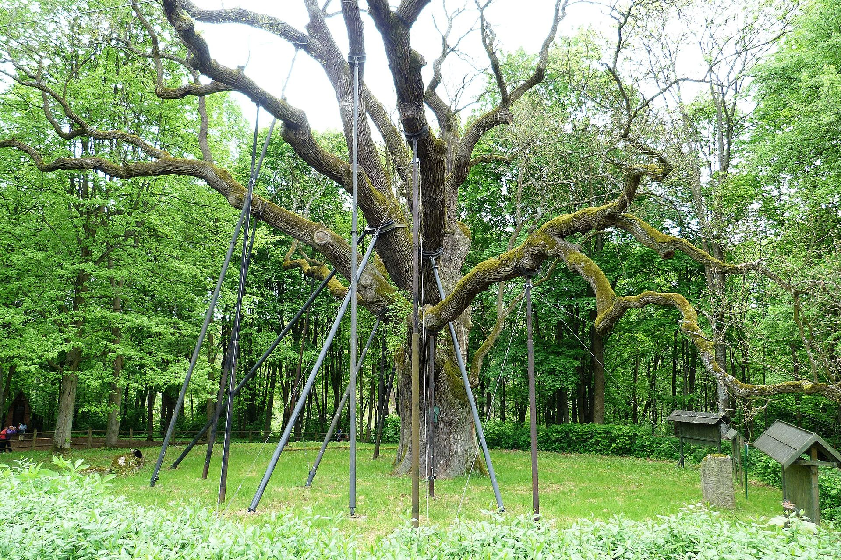

Slide 14
The 33,5-metre tall Bartek measures 970 cm at CBH (circumference at breast height) and 13.5 metres in girth at its base. Its crown spreads about 40 metres.

Slide 15
Vistula Spit (Mierzeja Wiślana)

Slide 16
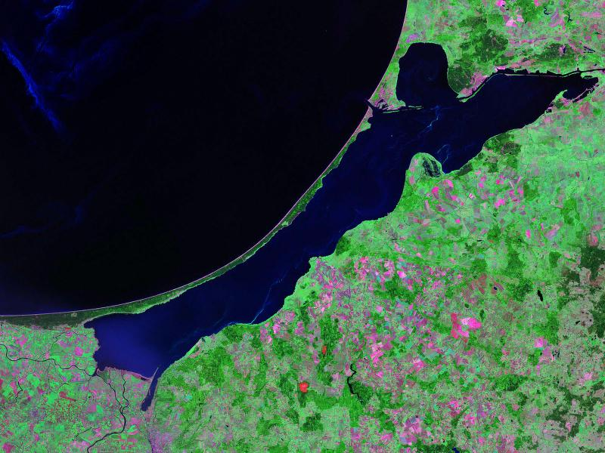

Slide 17
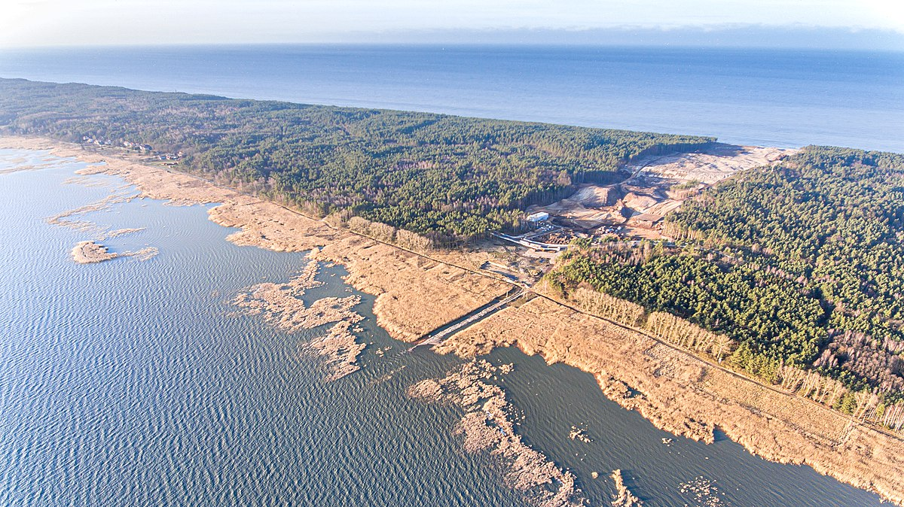

Slide 18
Ojców National Park

Slide 19
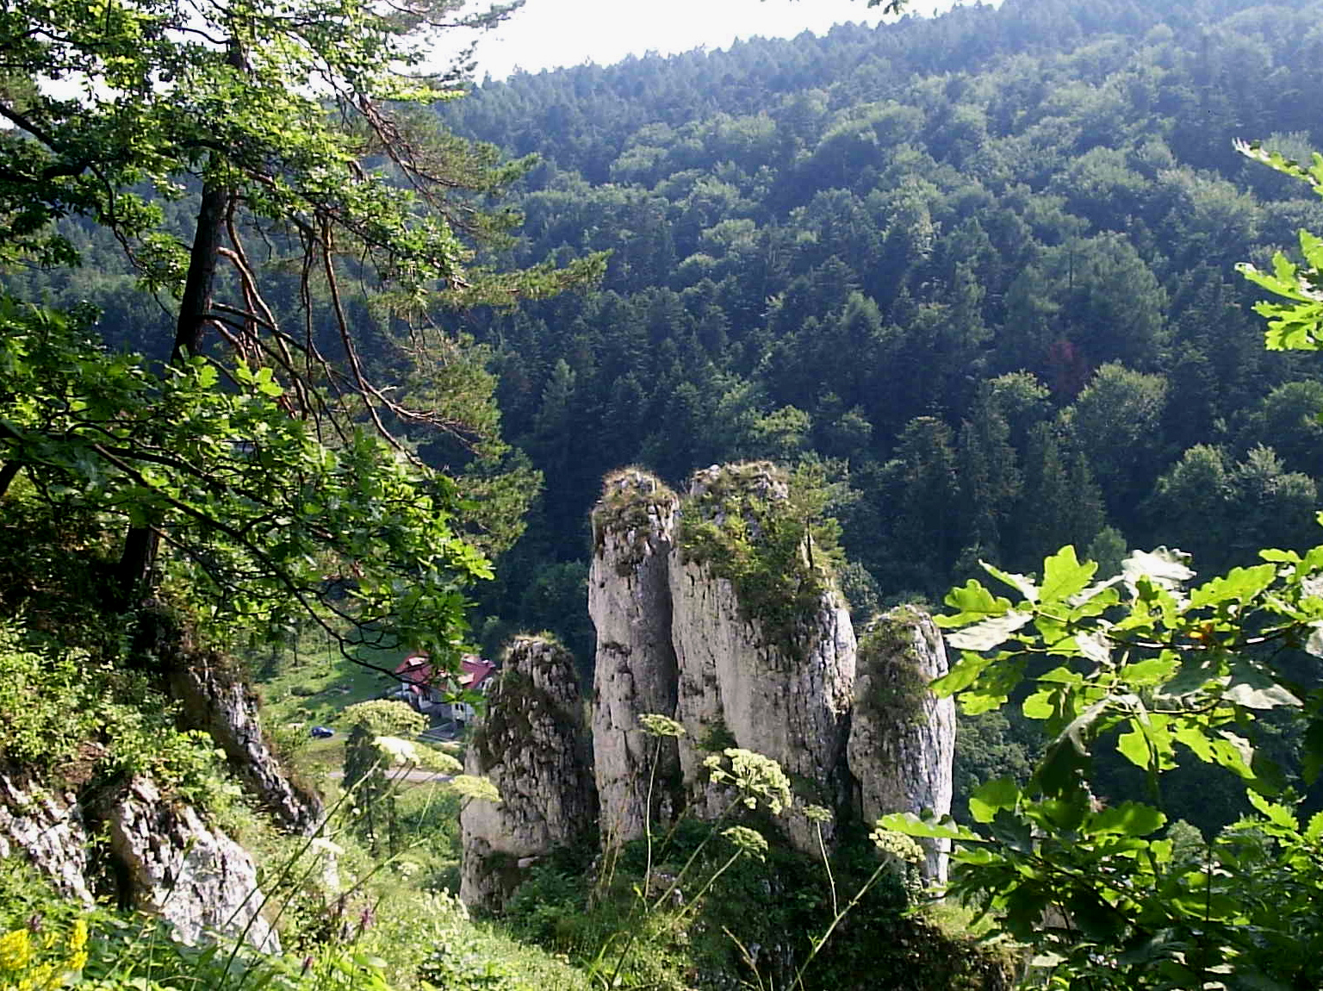

Slide 20
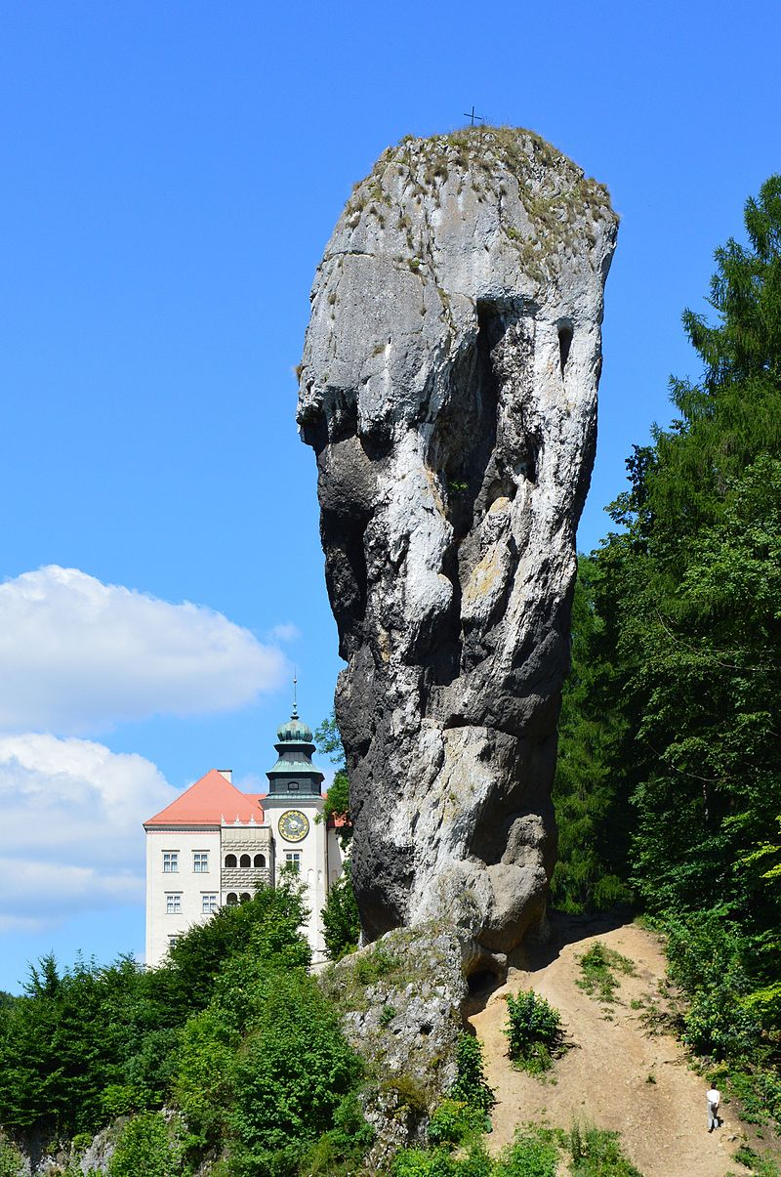

Slide 21
Thank you for your attention :)

