Slide 1
Museums in Tarnów

Slide 2
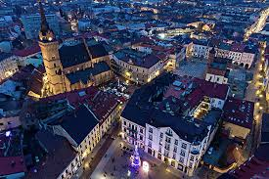
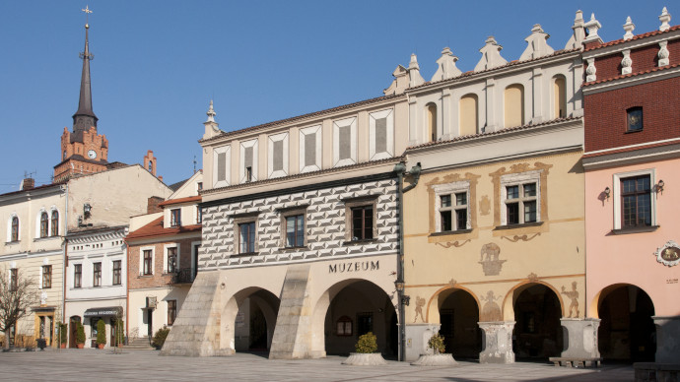
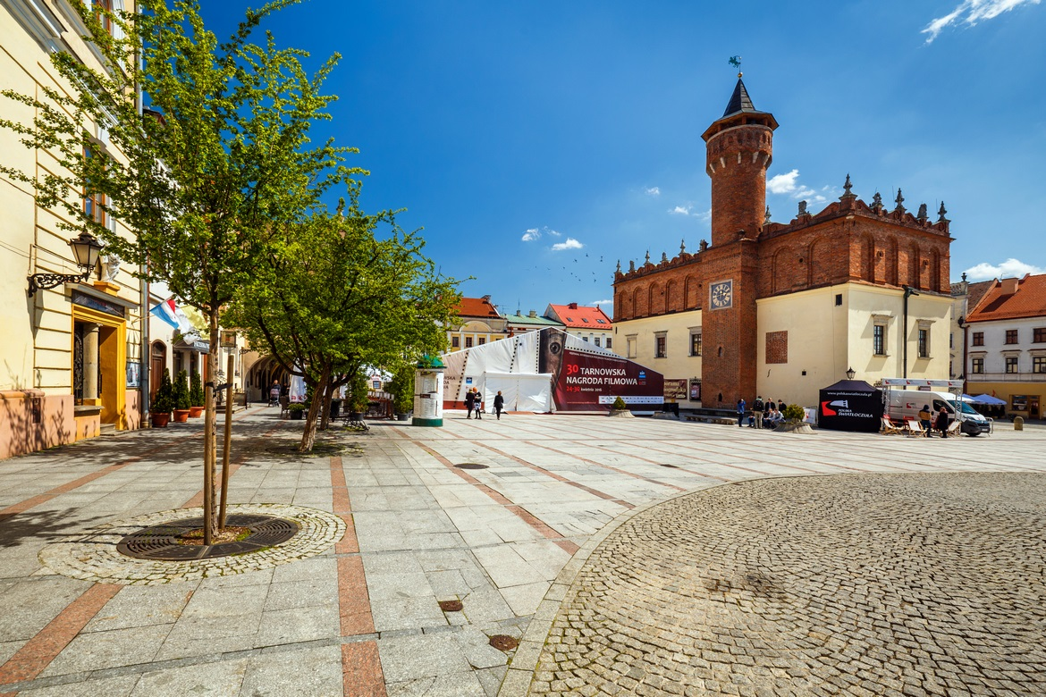

Slide 3
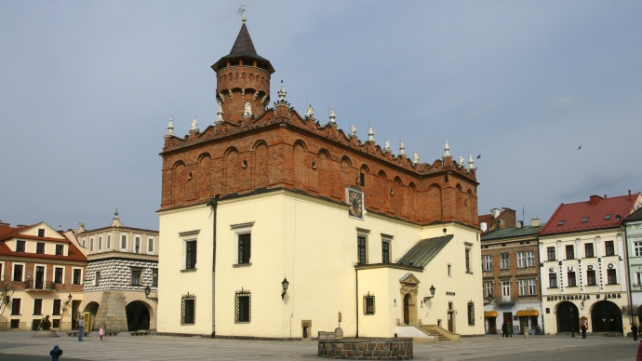
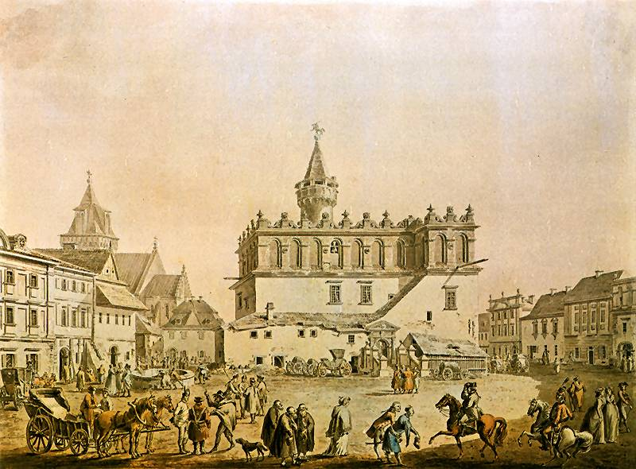
TOWN HALL
From the beginning of its existence until 1931 when it was allocated for museum purposes, the Town Hall was a building where town officials were residing. Built at the turn of the 16th century (1568) as a Gothic, brick building, it was altered in the 70s of the 16th century and gained a Renaissance look. This simple, cubic building was then crowned with a high, brick wall of an attic.

Slide 4
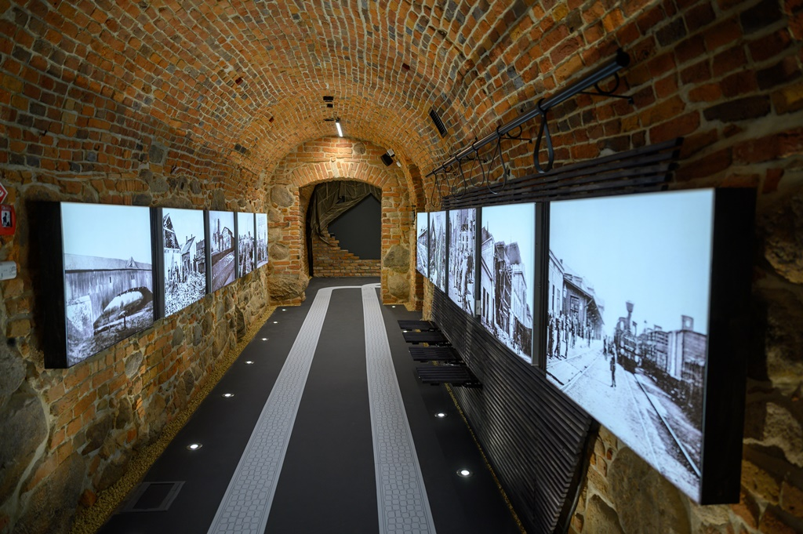
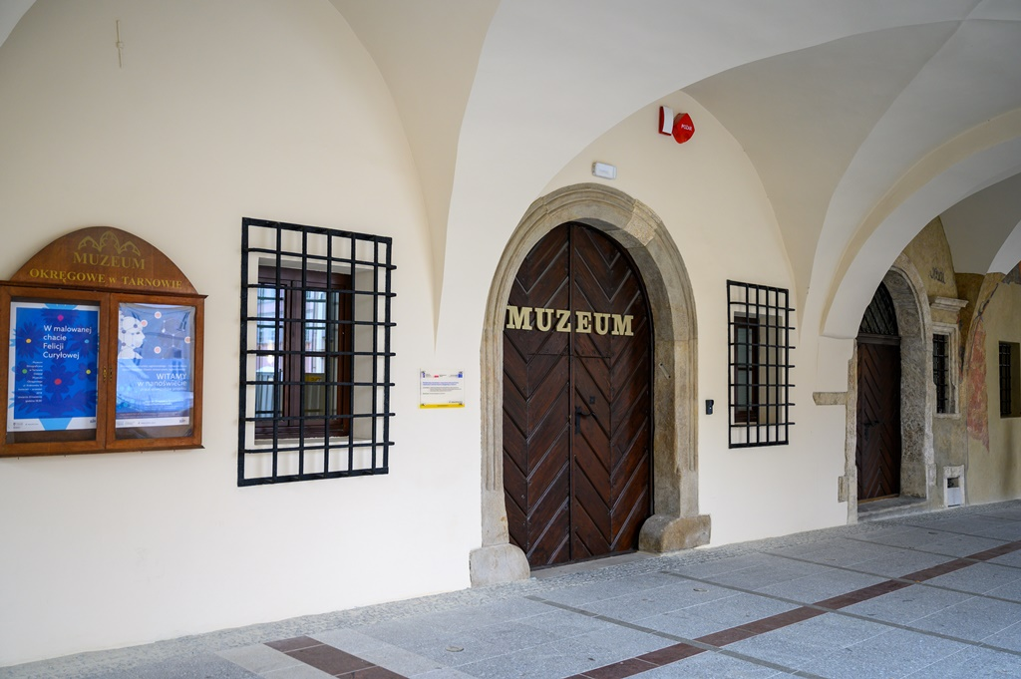
Museum od Tarnów’s history
The Main Building of the District Museum in Tarnów is located in a complex of sixteenth-century town houses at the Market Square in Tarnów.

Slide 5
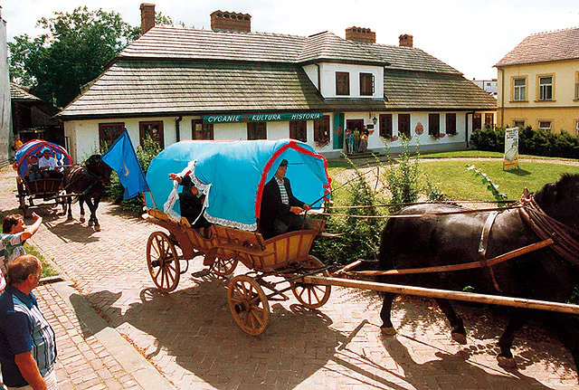
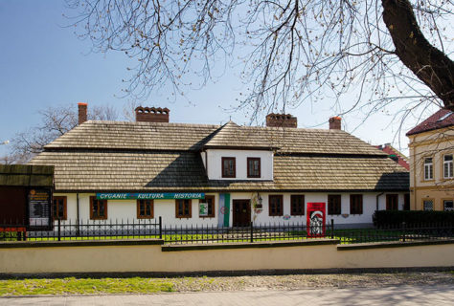
THE ETHNOGRAPHIC MUSEUM
This is a classical and historical manor house with old garden and two-floor granary built at the end of the 18th century. The beginnings of the Museum’s operations were based on a small ethnographic collection which currently consists of more than 5,000 items

Slide 6
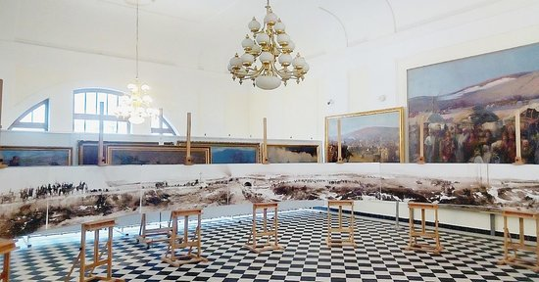
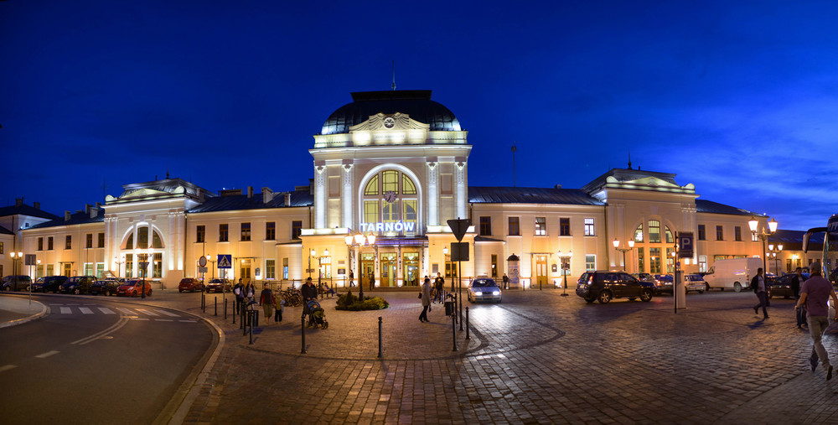
The “Panorama” gallery
In the “Panorama” Gallery located in the railway station building in Tarnów, a permanent exhibition is presented, devoted to the “Transylvanian Panorama” by Jan Styka and a team of painters under the direction of Jan Styka.

Slide 7
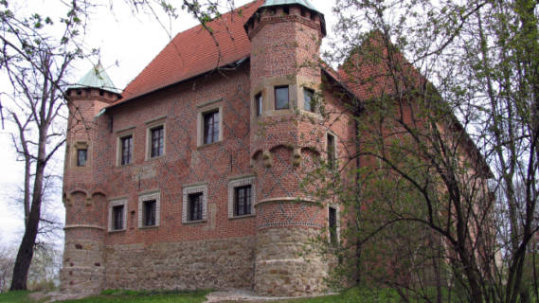
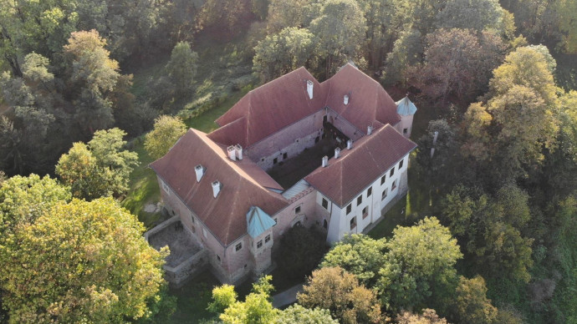
THE CASTLE IN DĘBNO
The Castle in Dębno is the only preserved in Małopolska historical building of magnate and residential architecture, erected at the end of the 15th century in the place of earlier buildings dating back to the 13th and 14th centuries, founded by Jakub Dębiński of the Odrowąż coat of arms, the Castellan of Cracow, the Chancellor of Poland.

Slide 8
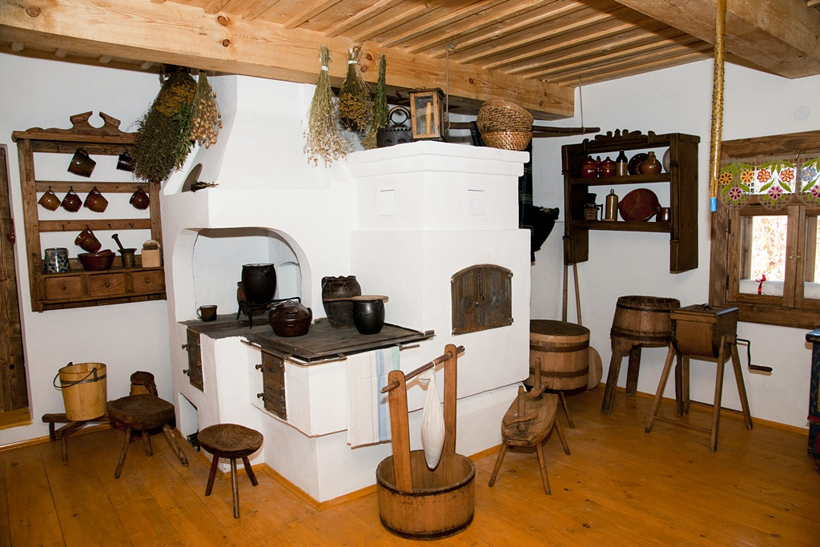
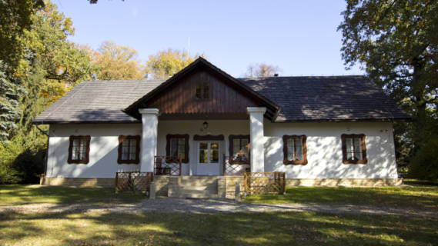
Manor house museum in Dołega
Manor House Museum in Dołęga, one of the branches of the District Museum in Tarnów, is located in a wooden, larch originally, manor erected in 1848 for its first owners: Maria and Aleksander Gunter.

Slide 9
Thank you

