Slide 1
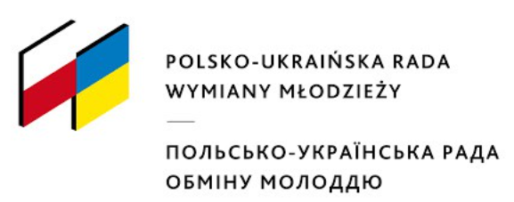
Material cultural heritage
Materialne dziedzictwo kulturowe
Матеріальна культурна спадщина

Slide 2
What is material cultural heritage?

Slide 3
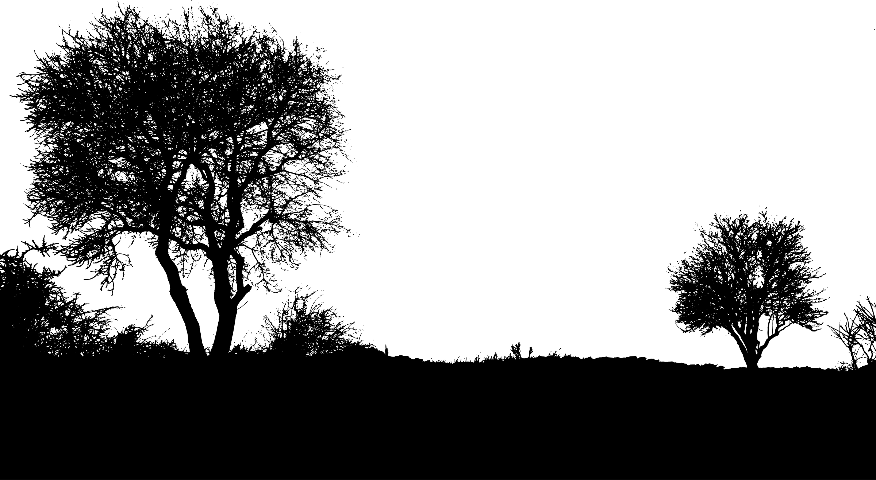
Material cultural heritage is very broad, including buildings, cultural landscapes, monuments, works of art, ethnological objects and many other things that are important bearers of historical memory and local identity, which preserve the diverse environment and reflect local traditions and society.

Slide 4
All psychical evidence of human creativity and expression
Artifacts (paintings, drawings, prints, mosaics, sculptures)
Historical monuments
Archaeological sites
Photographs, documents, books and manuscripts, and instruments

Slide 5
Heritage
Maintained in the present and bestowed upon future generations
Common ancestry of the entire nation
Contribution to the culture of the country/world

Slide 6
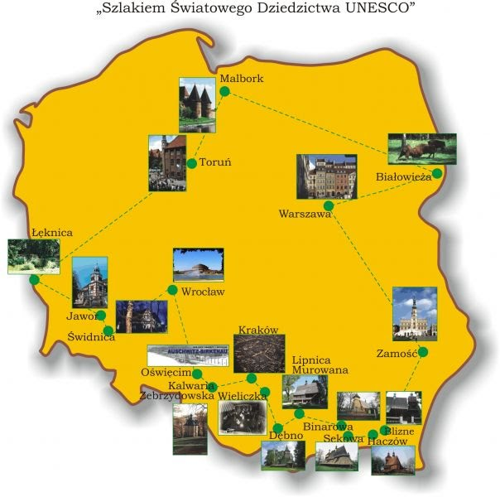
UNESCO
World Heritage Sites are places in the world which are very important from the cultural or natural point of view.
There are 16 UNESCO World Heritage Sites in Poland. The first properties were added to the World Heritage List in 1978.

Slide 7
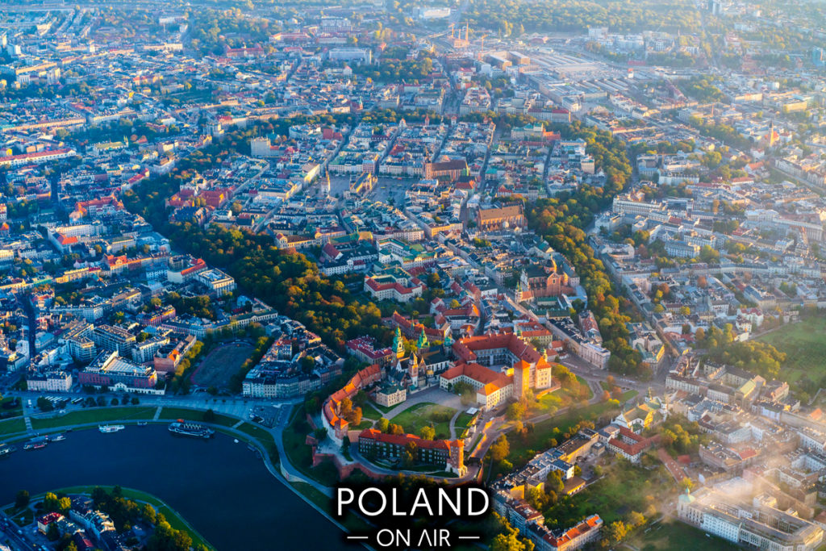
Kraków Old City

Slide 8
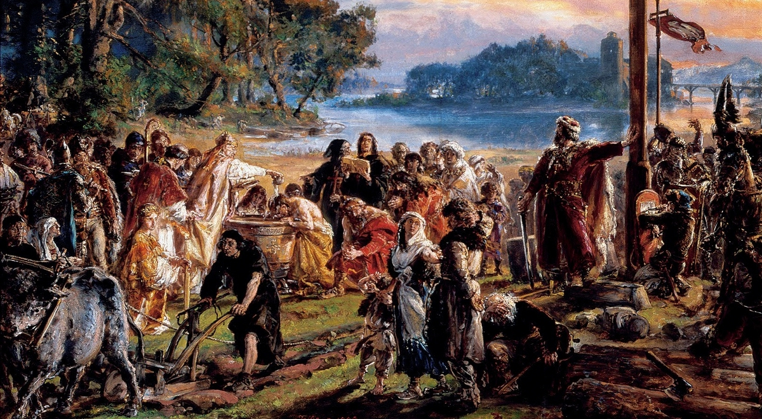
Jan Matejko paint

