Slide 2
ENVIRONMENTAL DANGERS
IN THE CZECH REPUBLIC
24.5.2023

Slide 3
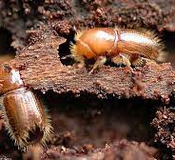
bark beetle scolytinae
Bark blight is a disease of trees and forests caused by bark beetles. As early as the end of the 18th century, regulations were issued in these countries to exterminate the beetle.

Slide 4
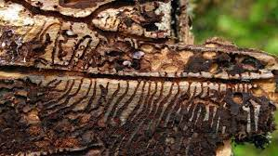
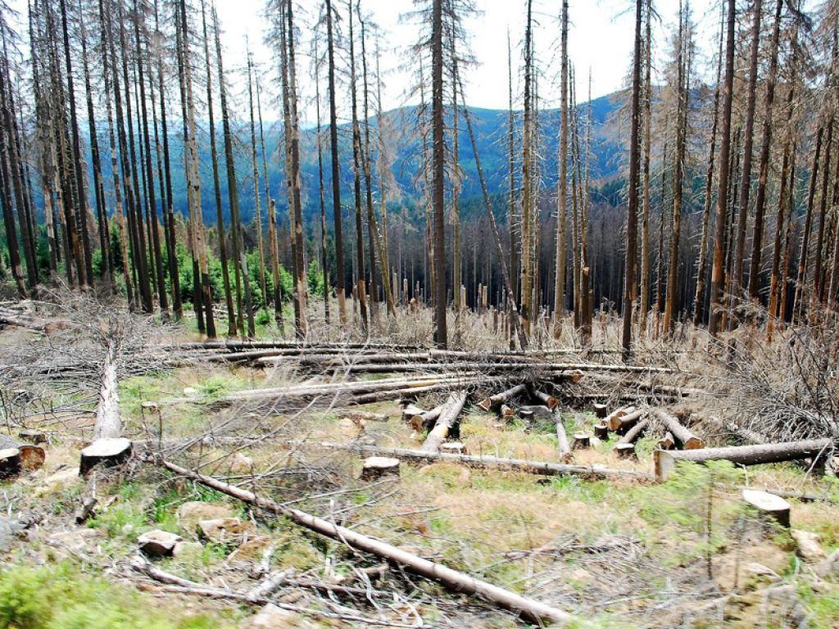
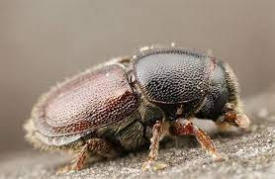

Slide 5
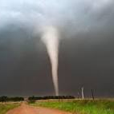
tornadoes
happen not as often
examples
2021 Hodonín, Břeclav
2018 Příbram
2018 Klatovy
2016 Červená Hora

Slide 6
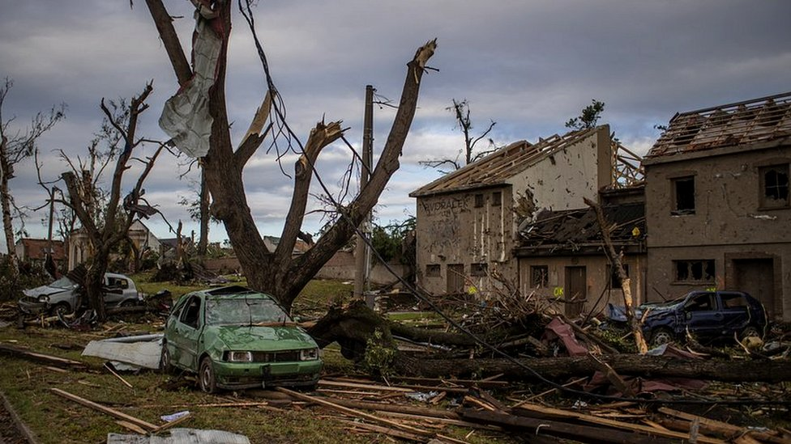

Slide 7
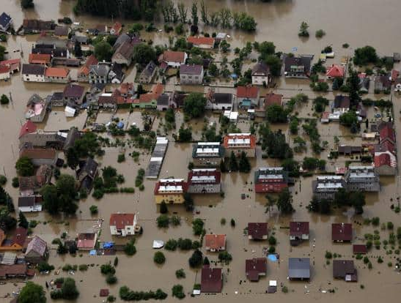
floods
In the Czech Republic the most destructive natural disasters result from floods. Evidence for this was the flood of July 1997 in Moravia and Silesia which took 52 lives and caused damage in excess of 63 billions Kč.
Similarly the flood in Bohemia in August 2002, took 19 lives and damage ran over 70 billions Kč.

Slide 8
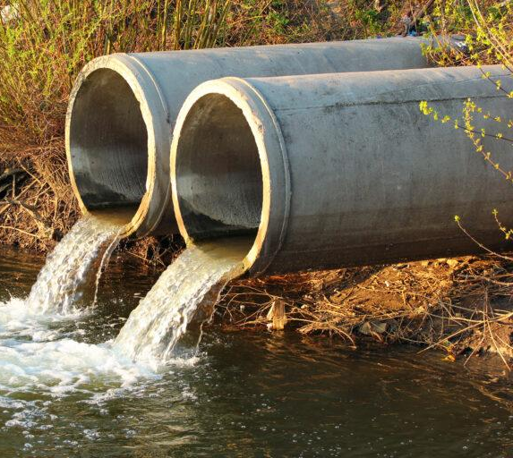
water pollution
The contamination of water sources by substances which make the water unusable for drinking, cooking, cleaning, swimming, and other activities.

Slide 9
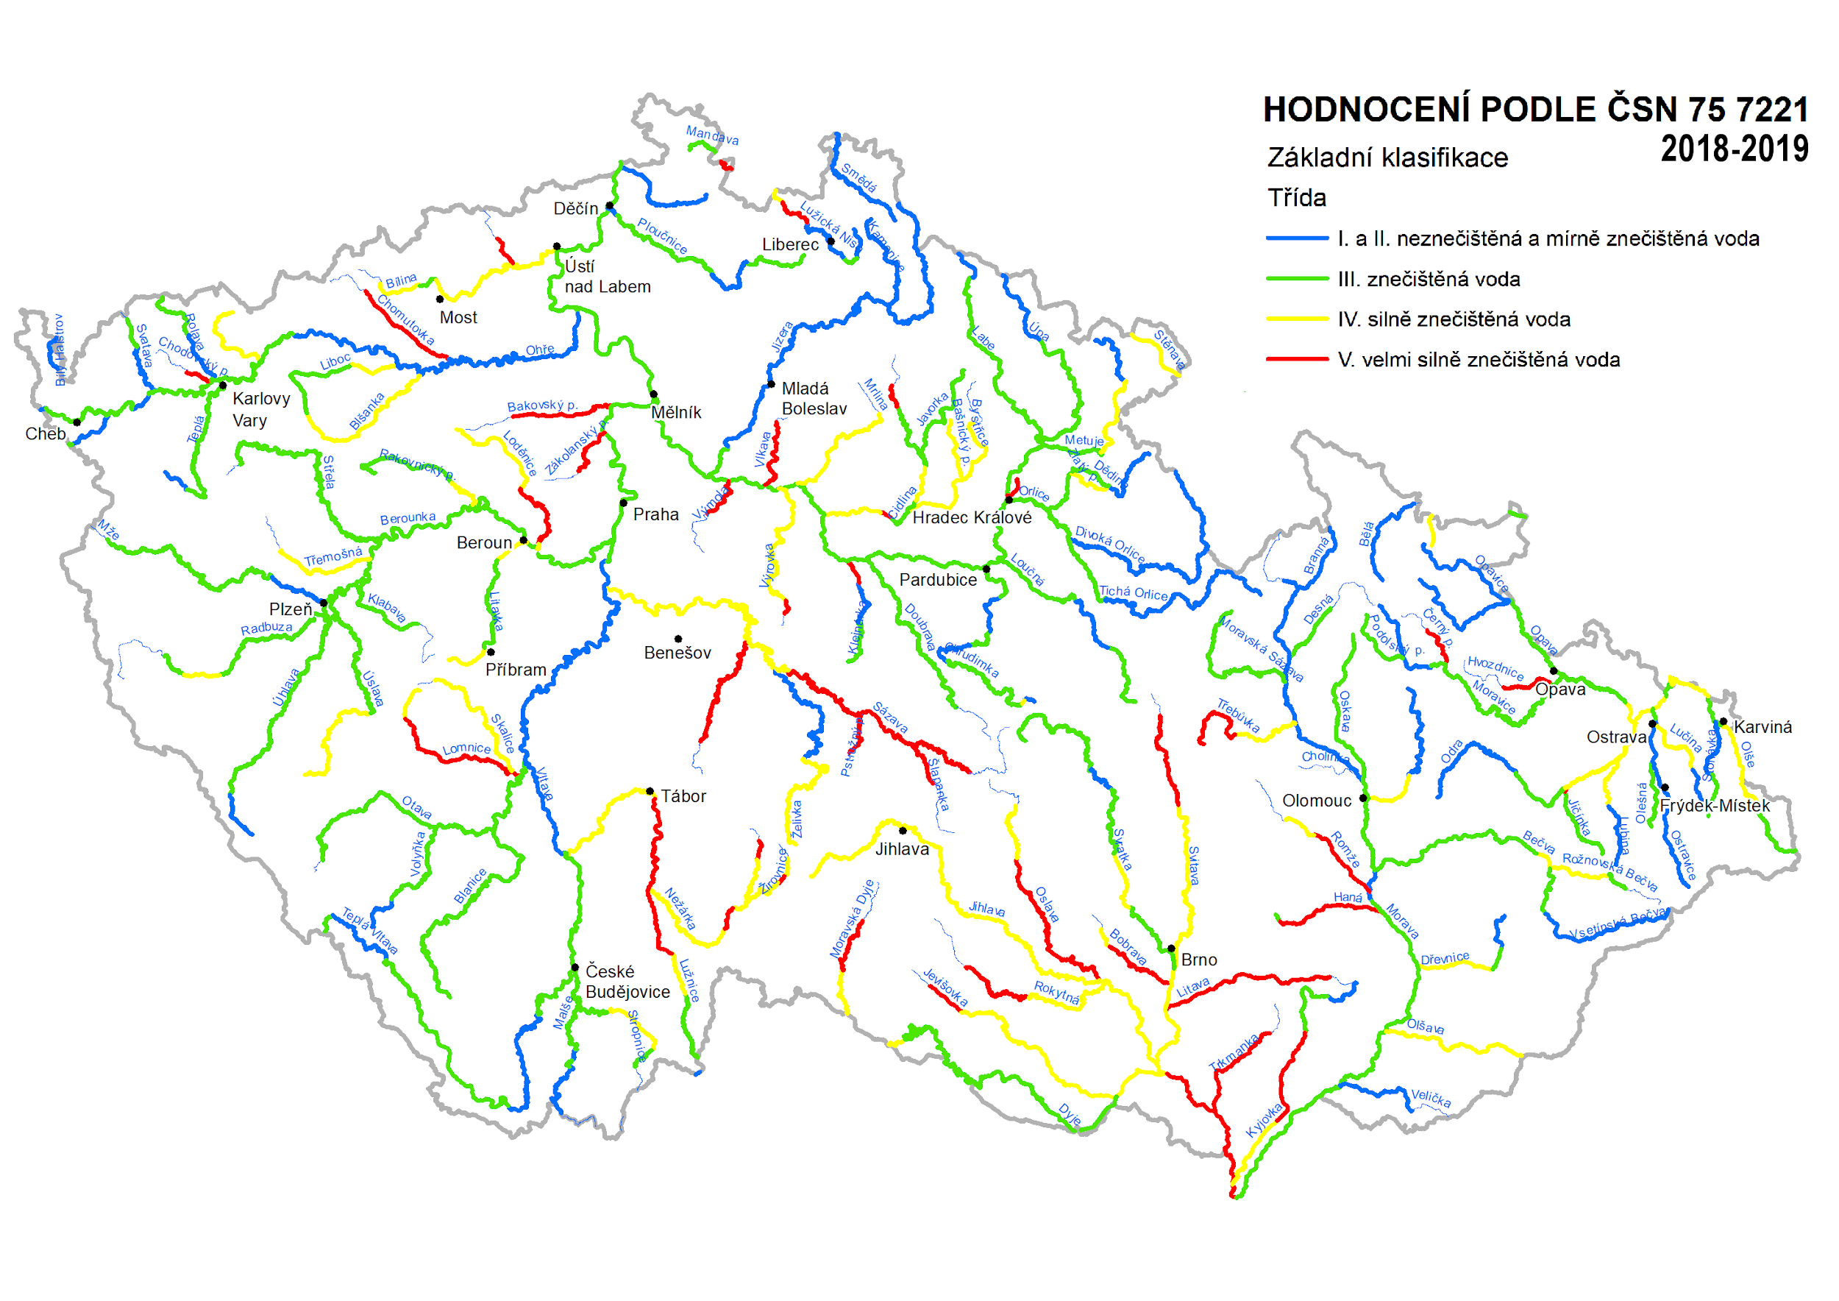

Slide 10
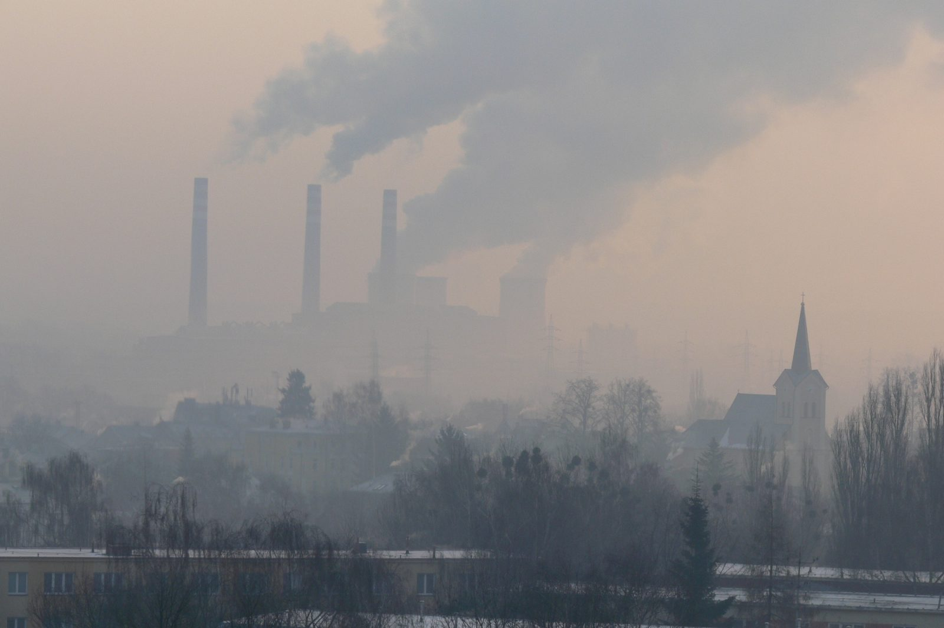
air pollution
The most important sources of air pollution in the Czech Republic are household heating, traffic, industry and transboundary air pollution.

