Slide 1
The Oxford Debate

Slide 7
Portugal…

Slide 8
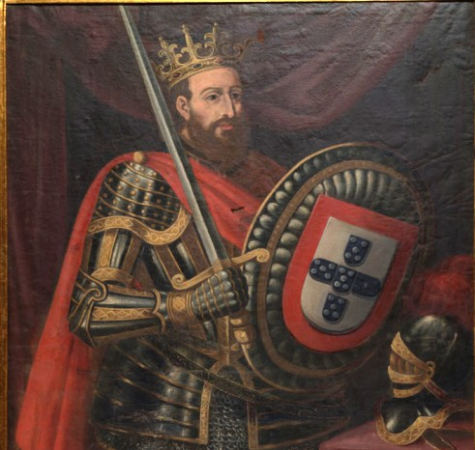

Slide 10
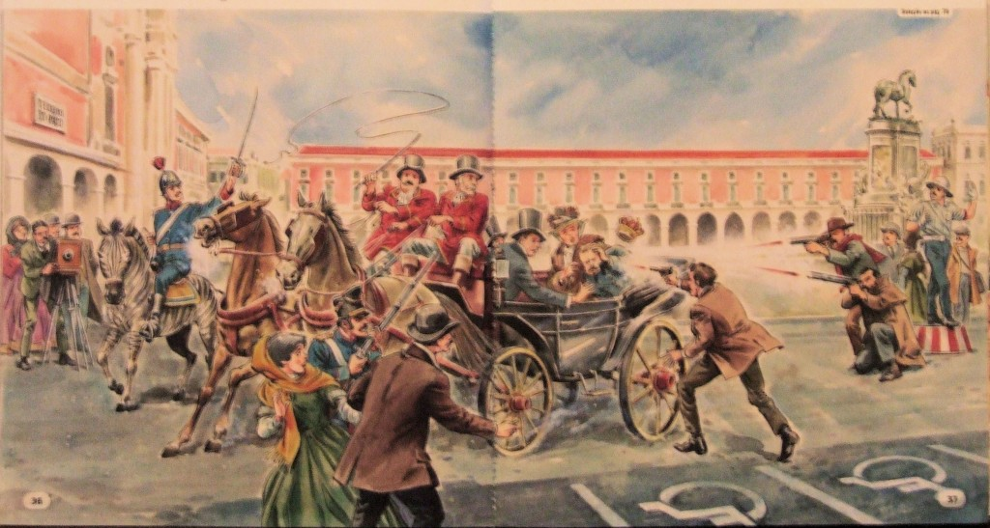

Slide 12
Dictatorship (1926-1974)
The Estado Novo, or the Second Republic, was the corporatist far-right regime installed in Portugal in 1933, which was considered clerical fascist. It evolved from the Ditadura Nacional formed after the coup d'état of 28 May 1926 against the democratic and unstable First Republic.

Slide 13
Dictatorship (1926-1974)
Olviveira Salazar: 1926 and 1968
Marcelo Caetano: 1968 and 1970

Slide 14
Revolution 25 de Abril
In the year of 1974

Slide 15
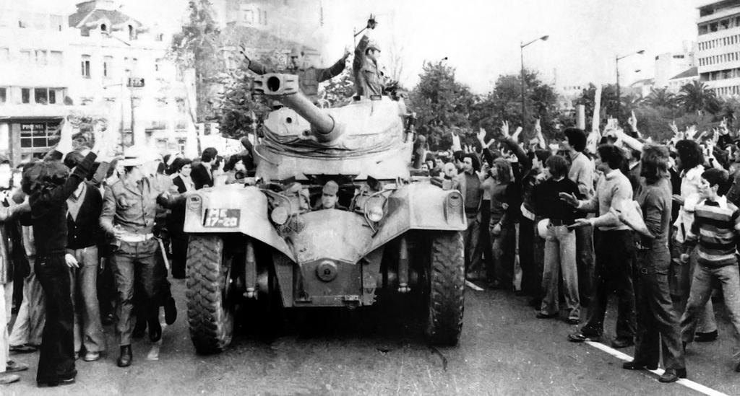

Slide 17
Military Regime 25 of April 1974 until April 2nd of 1976

Slide 18
Democracy April 2nd Until Today

Slide 19
Famous Debate
6 of November, 1975
Between Mário Soares (PS) and Álvaro Cunhal (PCP)

Slide 20
https://www.youtube.com/watch?v=BNpIOarNQ08

