Slide 1
A cultural debate in Sofia
Banitsa people

Slide 2
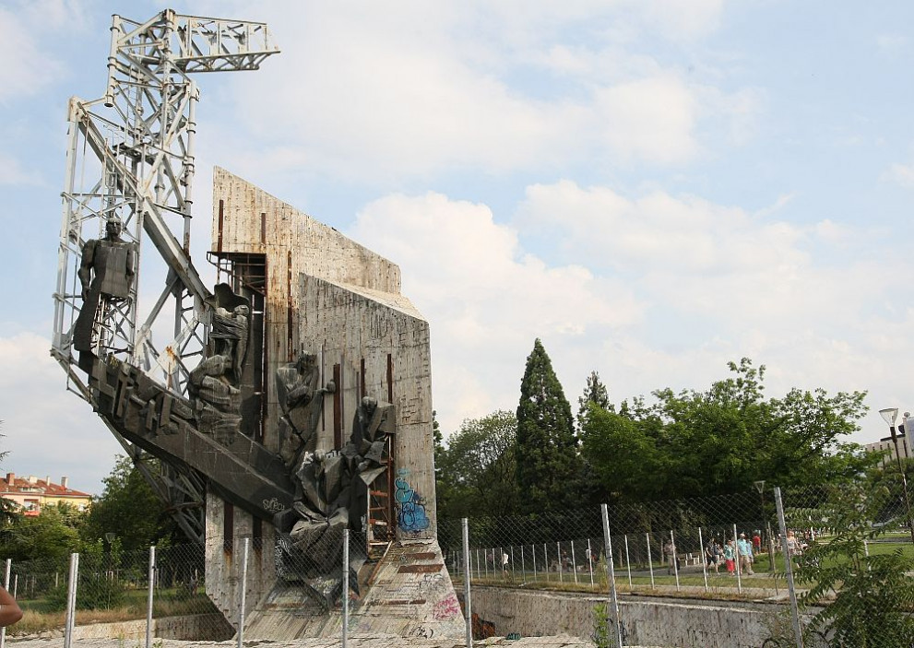
The conflict maker
1981;
32m;
National Palace of Culture;
Sofia, Bulgaria.

Slide 3
Brief history
This is possibly the world's shoddiest monument ever.
It was supposed to celebrate 1300 years of Bulgarian history but only stood for a pathetic few years.

Slide 4
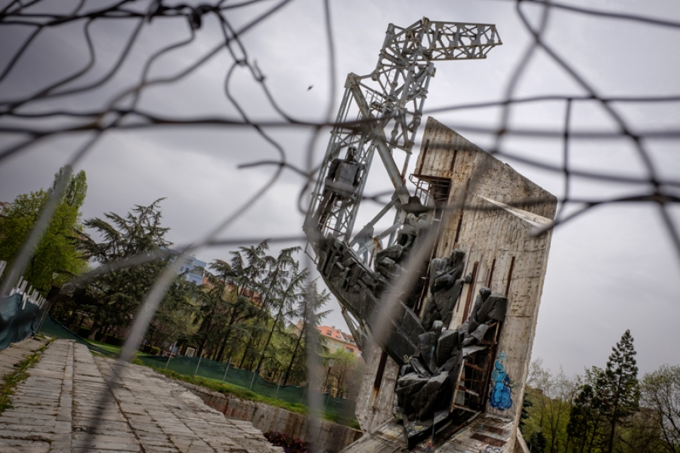

Slide 5
The debate
Since 2014 it was decided that the monument should be demolished.
But it happened in 2017.
Debate: 2017 – 2014 = 3 years.

Slide 6
Some people thought it was a dangerous piece of junk.
Other fought that it was part of the cultural history; and it didn’t matter whether the history was dark.

Slide 7
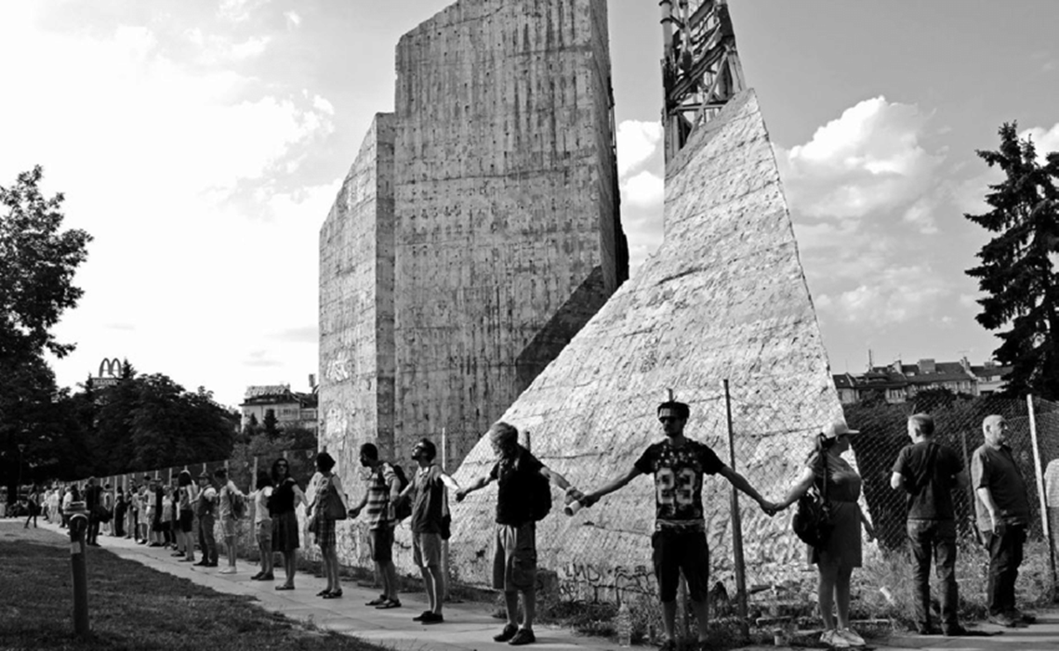

Slide 8
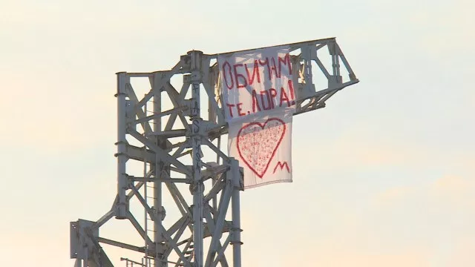
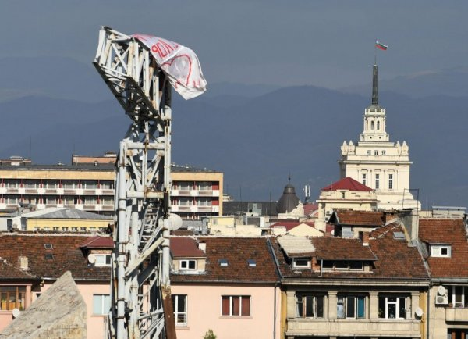
Love signs, graffity

Slide 9
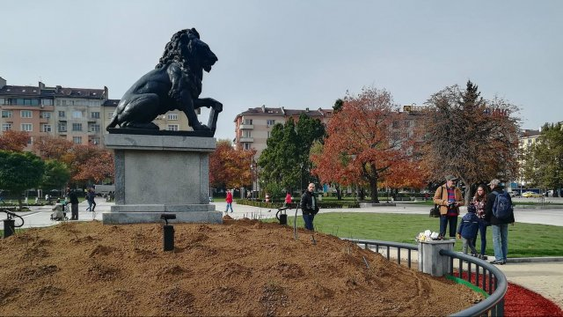
The new/old monument
- Same bronze lion monument in 1934;
- Made in honor of 1st And 6th regiments;

Slide 10
Thank you for your attention.

