Slide 1
Examples of cultural heritage in Poland

Slide 2
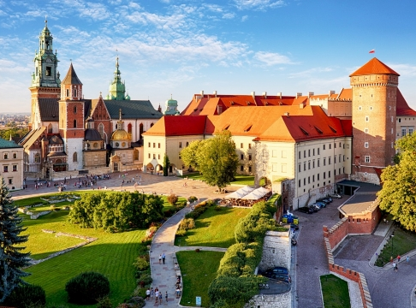
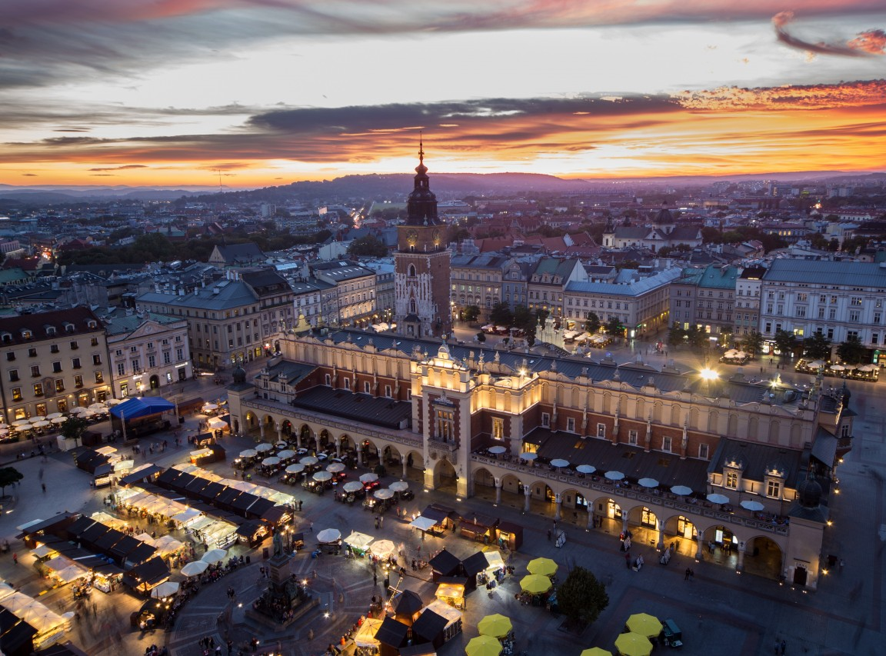
Historic Centre of Cracow
The Historic Centre of Kraków, the former capital of Poland, is situated at the foot of the Royal Wawel Castle.
Wawel Castle was the seat of the polish kings and their coronation
The 13th-century merchants' town has Europe's largest market square and numerous historical houses, palaces and churches
It’s embellished by the Cloth Hall, St Mary’s Church and many old houses, each with its own historical genealogy.

Slide 3
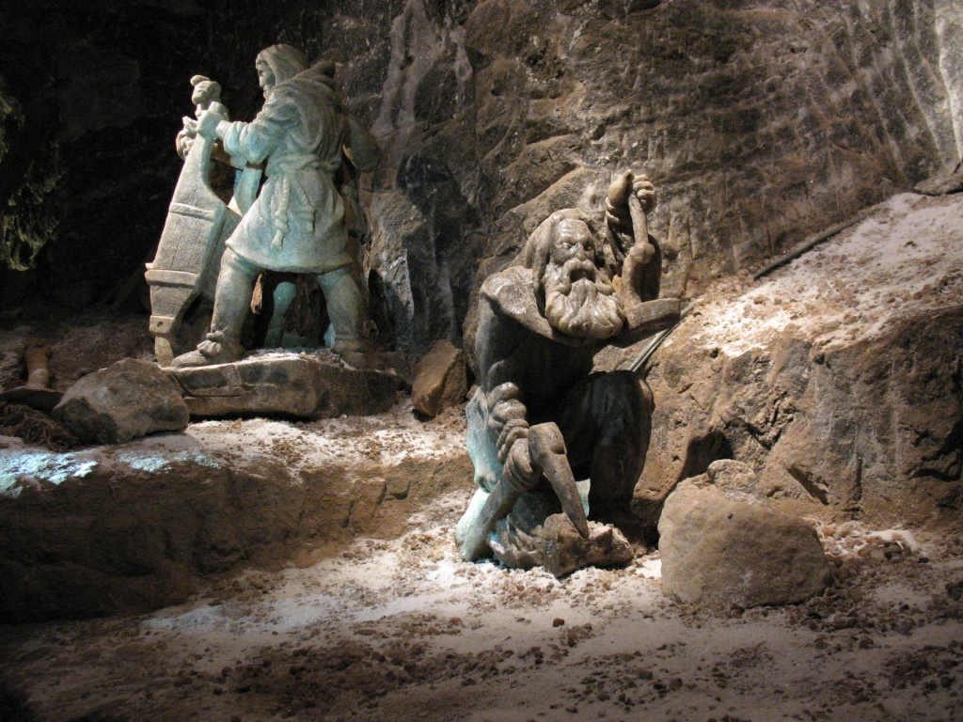
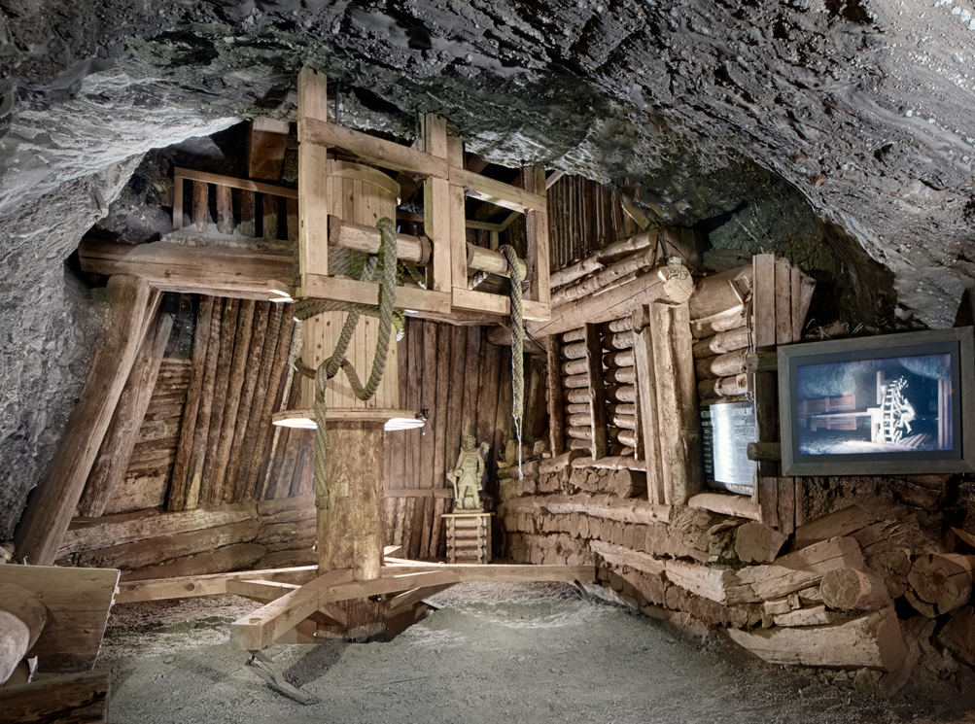
Wieliczka & Bochnia Royal Salt Mines
The Wieliczka and Bochnia Royal Salt Mines illustrate the historic stages of the development of mining techniques in Europe from the 13th to the 20th centuries
Both mines have hundreds of kilometers of galleries with works of art, underground chapels and statues sculpted in the salt, making a fascinating pilgrimage into the past.

Slide 4
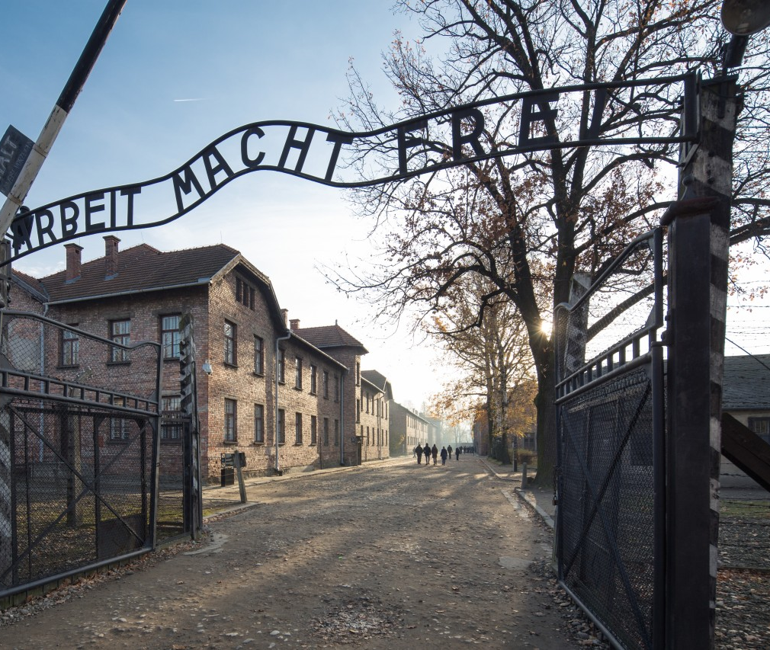
Auschwitz Birkenau, Nazi German Concentration & Extermination Camp
The scene of martyrdom of millions of people during World War II
The largest Nazi concentration camp in German-occupied Europe.
The concentration camp named Auschwitz I was established in April 1940 on the outskirts of Oświęcim.
The main extermination center and the world’s largest cemetery, Birkenau, was built in the suburbs of Oświęcim in 1942.

Slide 5
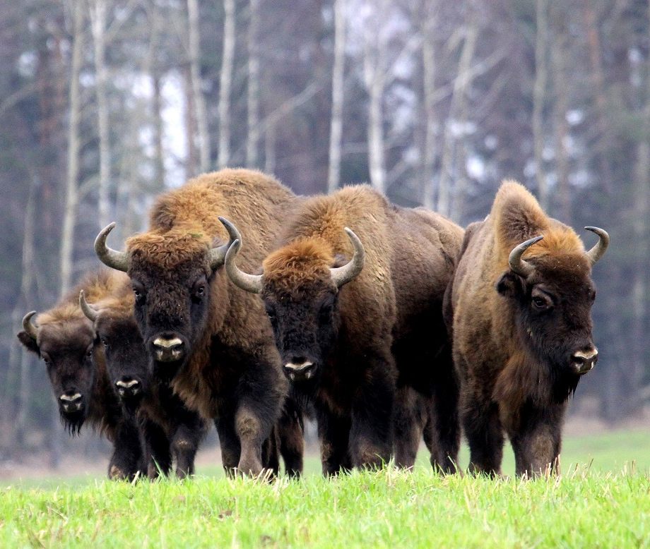
Białowieża Forest
The Białowieża Forest is a vast forest complex, consisting of the remnants of several primeval forests: Białowieża Forest, Ladzka Forest, Świsłocka Forest and Szereszewska Forest.
This large expanse of natural forest is located on the country's eastern border and distributed roughly evenly between Poland and Belarus.
The symbol of the Białowieża Fores is the European Bison

Slide 6
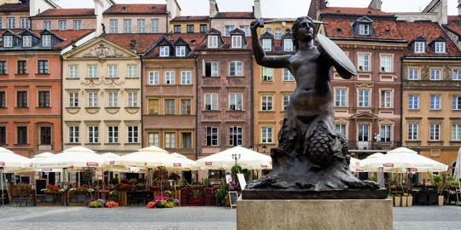
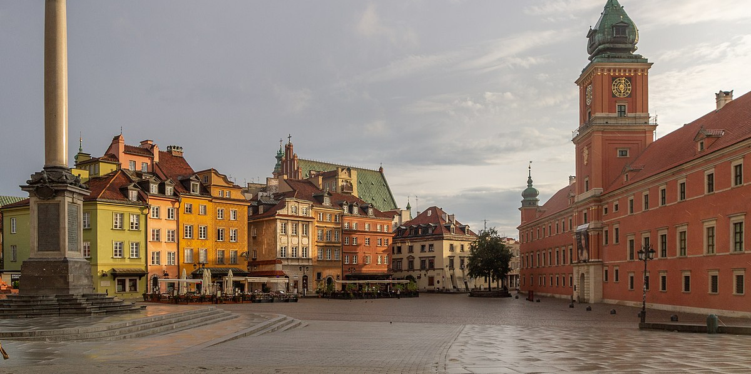
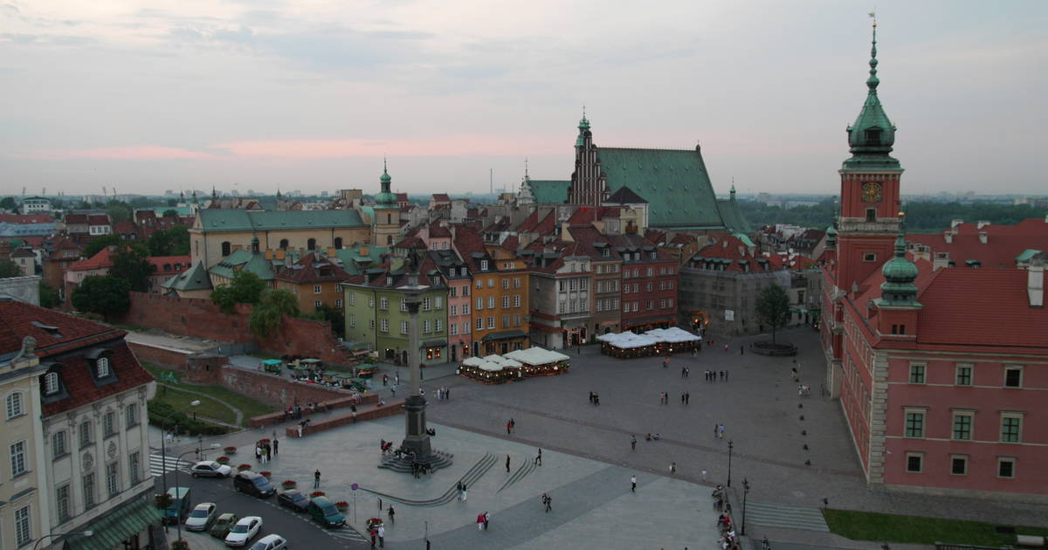
Historic Centre of Warsaw
During the Warsaw Uprising in August 1944, more than 85% of Warsaw's historic centre was destroyed by Nazi troops. After the war, a five-year reconstruction campaign by its citizens resulted in today's meticulous restoration of the Old Town, with its churches, palaces and market-place. It is an outstanding example of a near-total reconstruction of a span of history covering the 13th to the 20th century.

Slide 7
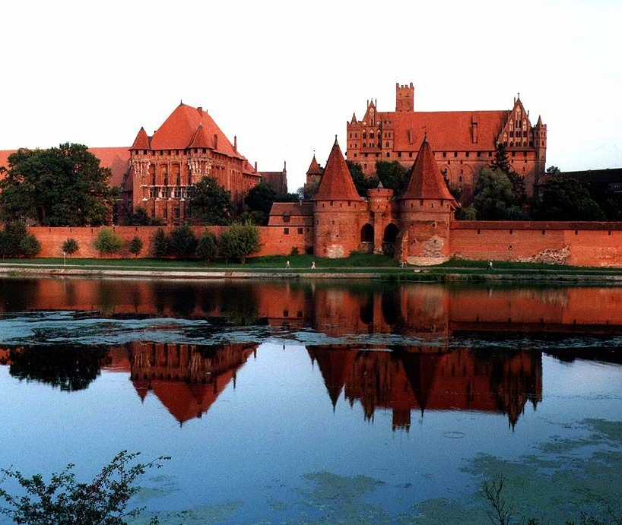
Castle of the Teutonic Order in Malbork
It is a thirteenth-century monastery belonging to the Teutonic Order
The Grand Master’s palace is believed to be the highest achievement in the late-Gothic style.
Now a museum, the castle attracts tourists with open-air events that feature the Siege of Malbork and other shows

Slide 8
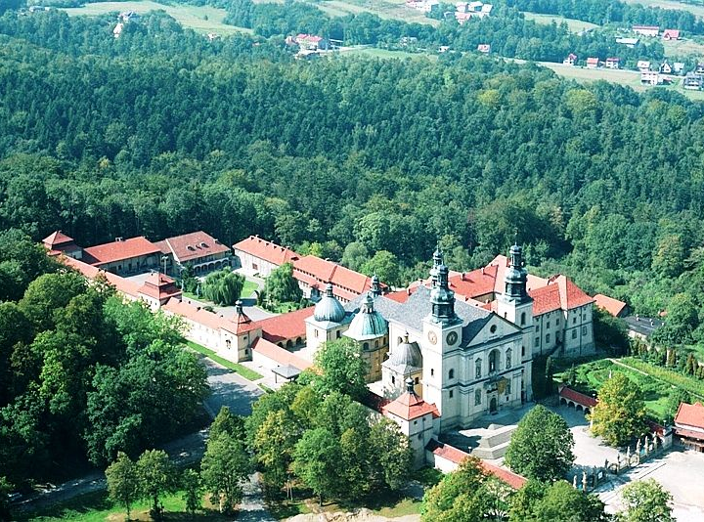
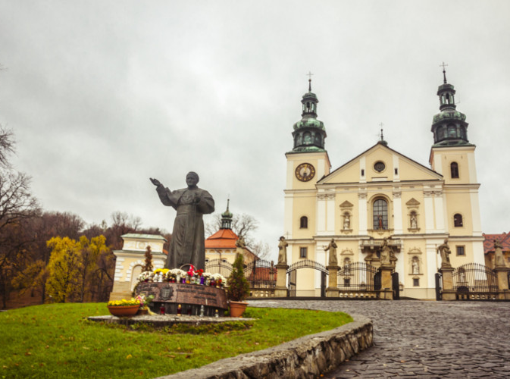
Kalwaria Zebrzydowska
Kalwaria Zebrzydowska is a breathtaking cultural landscape of great spiritual significance.
The Calvary, the Way of the Cross, is lined with shrines, chapels and small churches and is picturesquely set on hills and in the valley of a stream.
The most important processions are held during Holy Week (Easter) and on Our Lady’s Assumption Day.

Slide 9
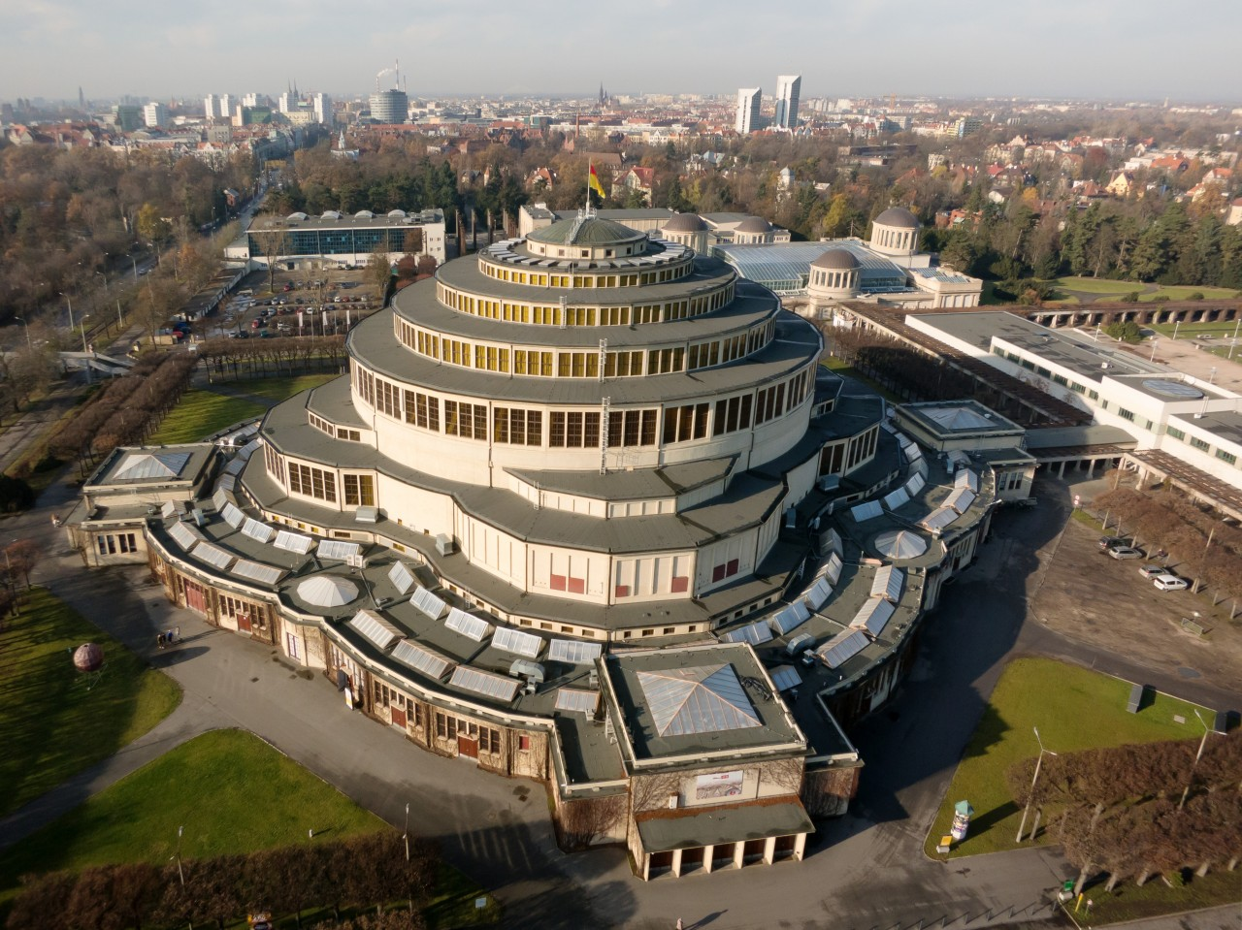
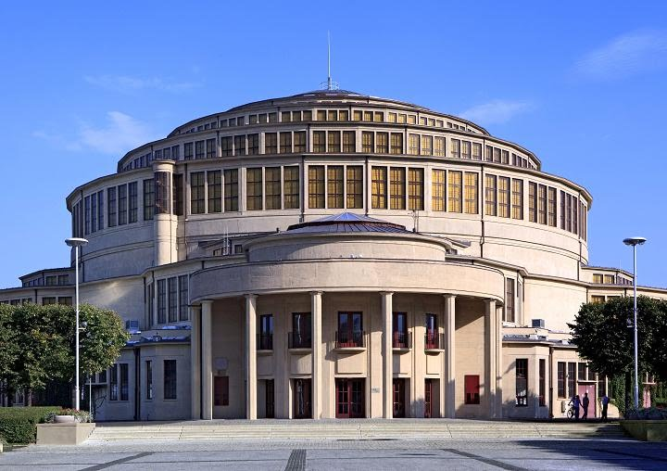
Centennial Hall in Wroclaw
It was constructed between 1911 and 1913, in commemoration of the hundredth anniversary of the Battle of the Nations, fought with Napoleon (1813)
In form it is a symmetrical quatrefoil with a vast circular central space that can seat some 6,000 persons. The 23m-high dome is topped with a lantern in steel and glass.
The Centennial Hall is a pioneering work of modern engineering and architecture, which exhibits an important interchange of influences in the early 20th century, becoming a key reference in the later development of reinforced concrete structures.

