Slide 1
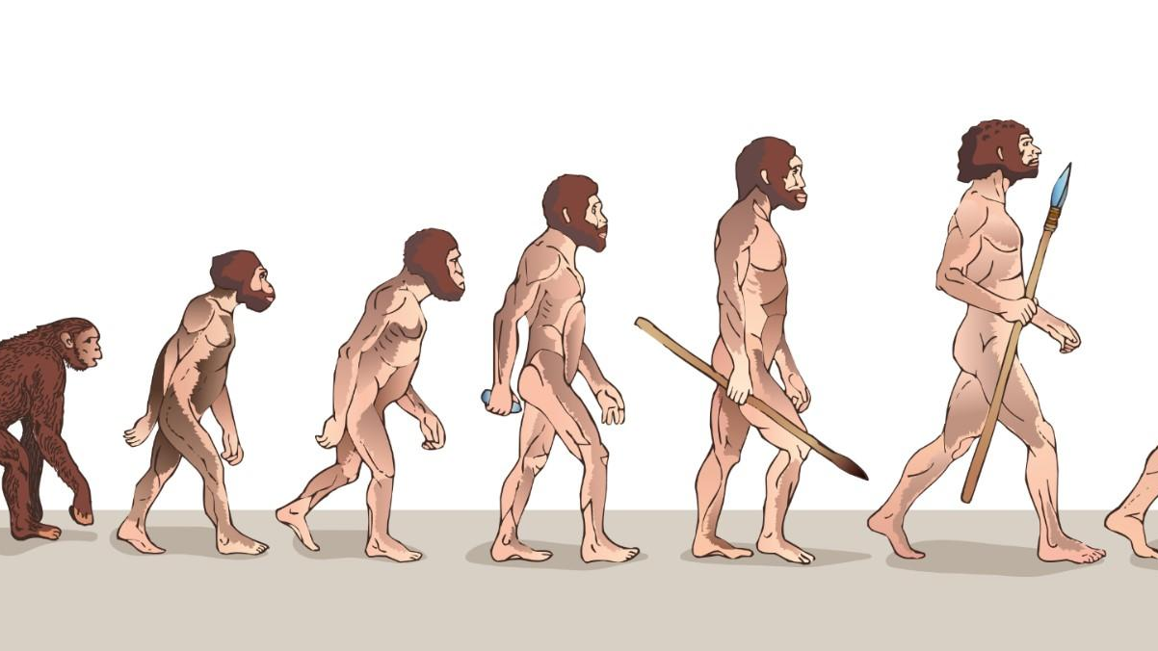
Prehistory
Scul(p)tures

Slide 2
Prehistory
WHAT?
WHEN?
WHERE?
WHO?
HOW?
WHY?

Slide 3
Venus Wiilendorf

Slide 4
sTONEHENGE

Slide 5
Easter Islands

Slide 6
The end

