Slide 1
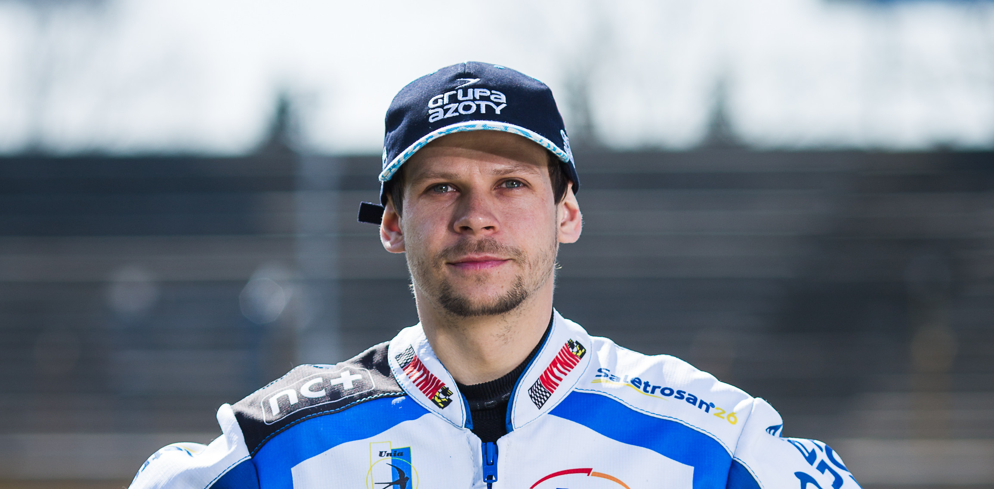
Janusz Kołodziej

Slide 2
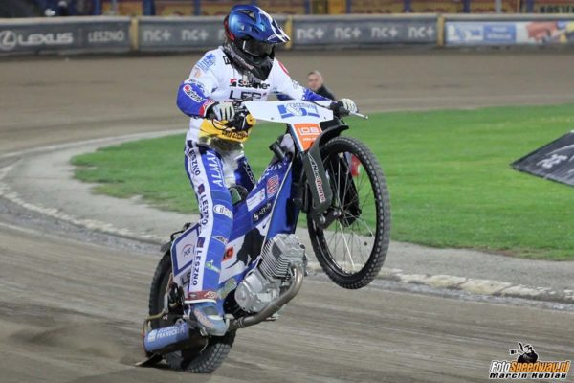
Janusz Kołodziej (born 27 May 1984 in Tarnów, Poland) is a Polish speedway rider who has ridden for the Polish national team.

Slide 3
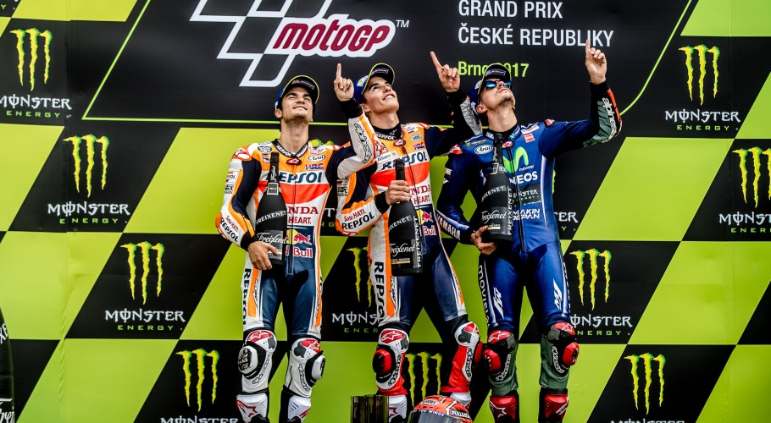
Speedway Grand Prix results
He won Grand Prix Czech in Praga in 2019.
He also took place on the podium in Grand Prix Poland in Bydgoszcz in 2010.

Slide 4
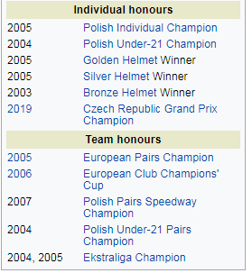

Slide 5
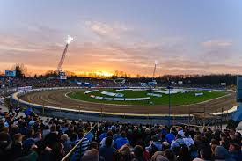
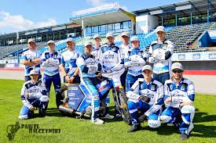
He was member of the Unia Tarnów club for 15 years

Slide 6
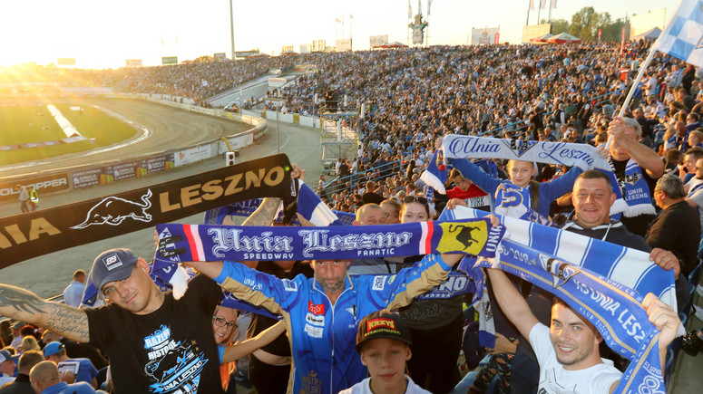
Now he is member of Unia Leszno.

Slide 7
Janusz Kołodziej was a member of national speedway team.

