Slide 1
5 places in Tarnów
Autor:Maciej Wilczyński

Slide 2
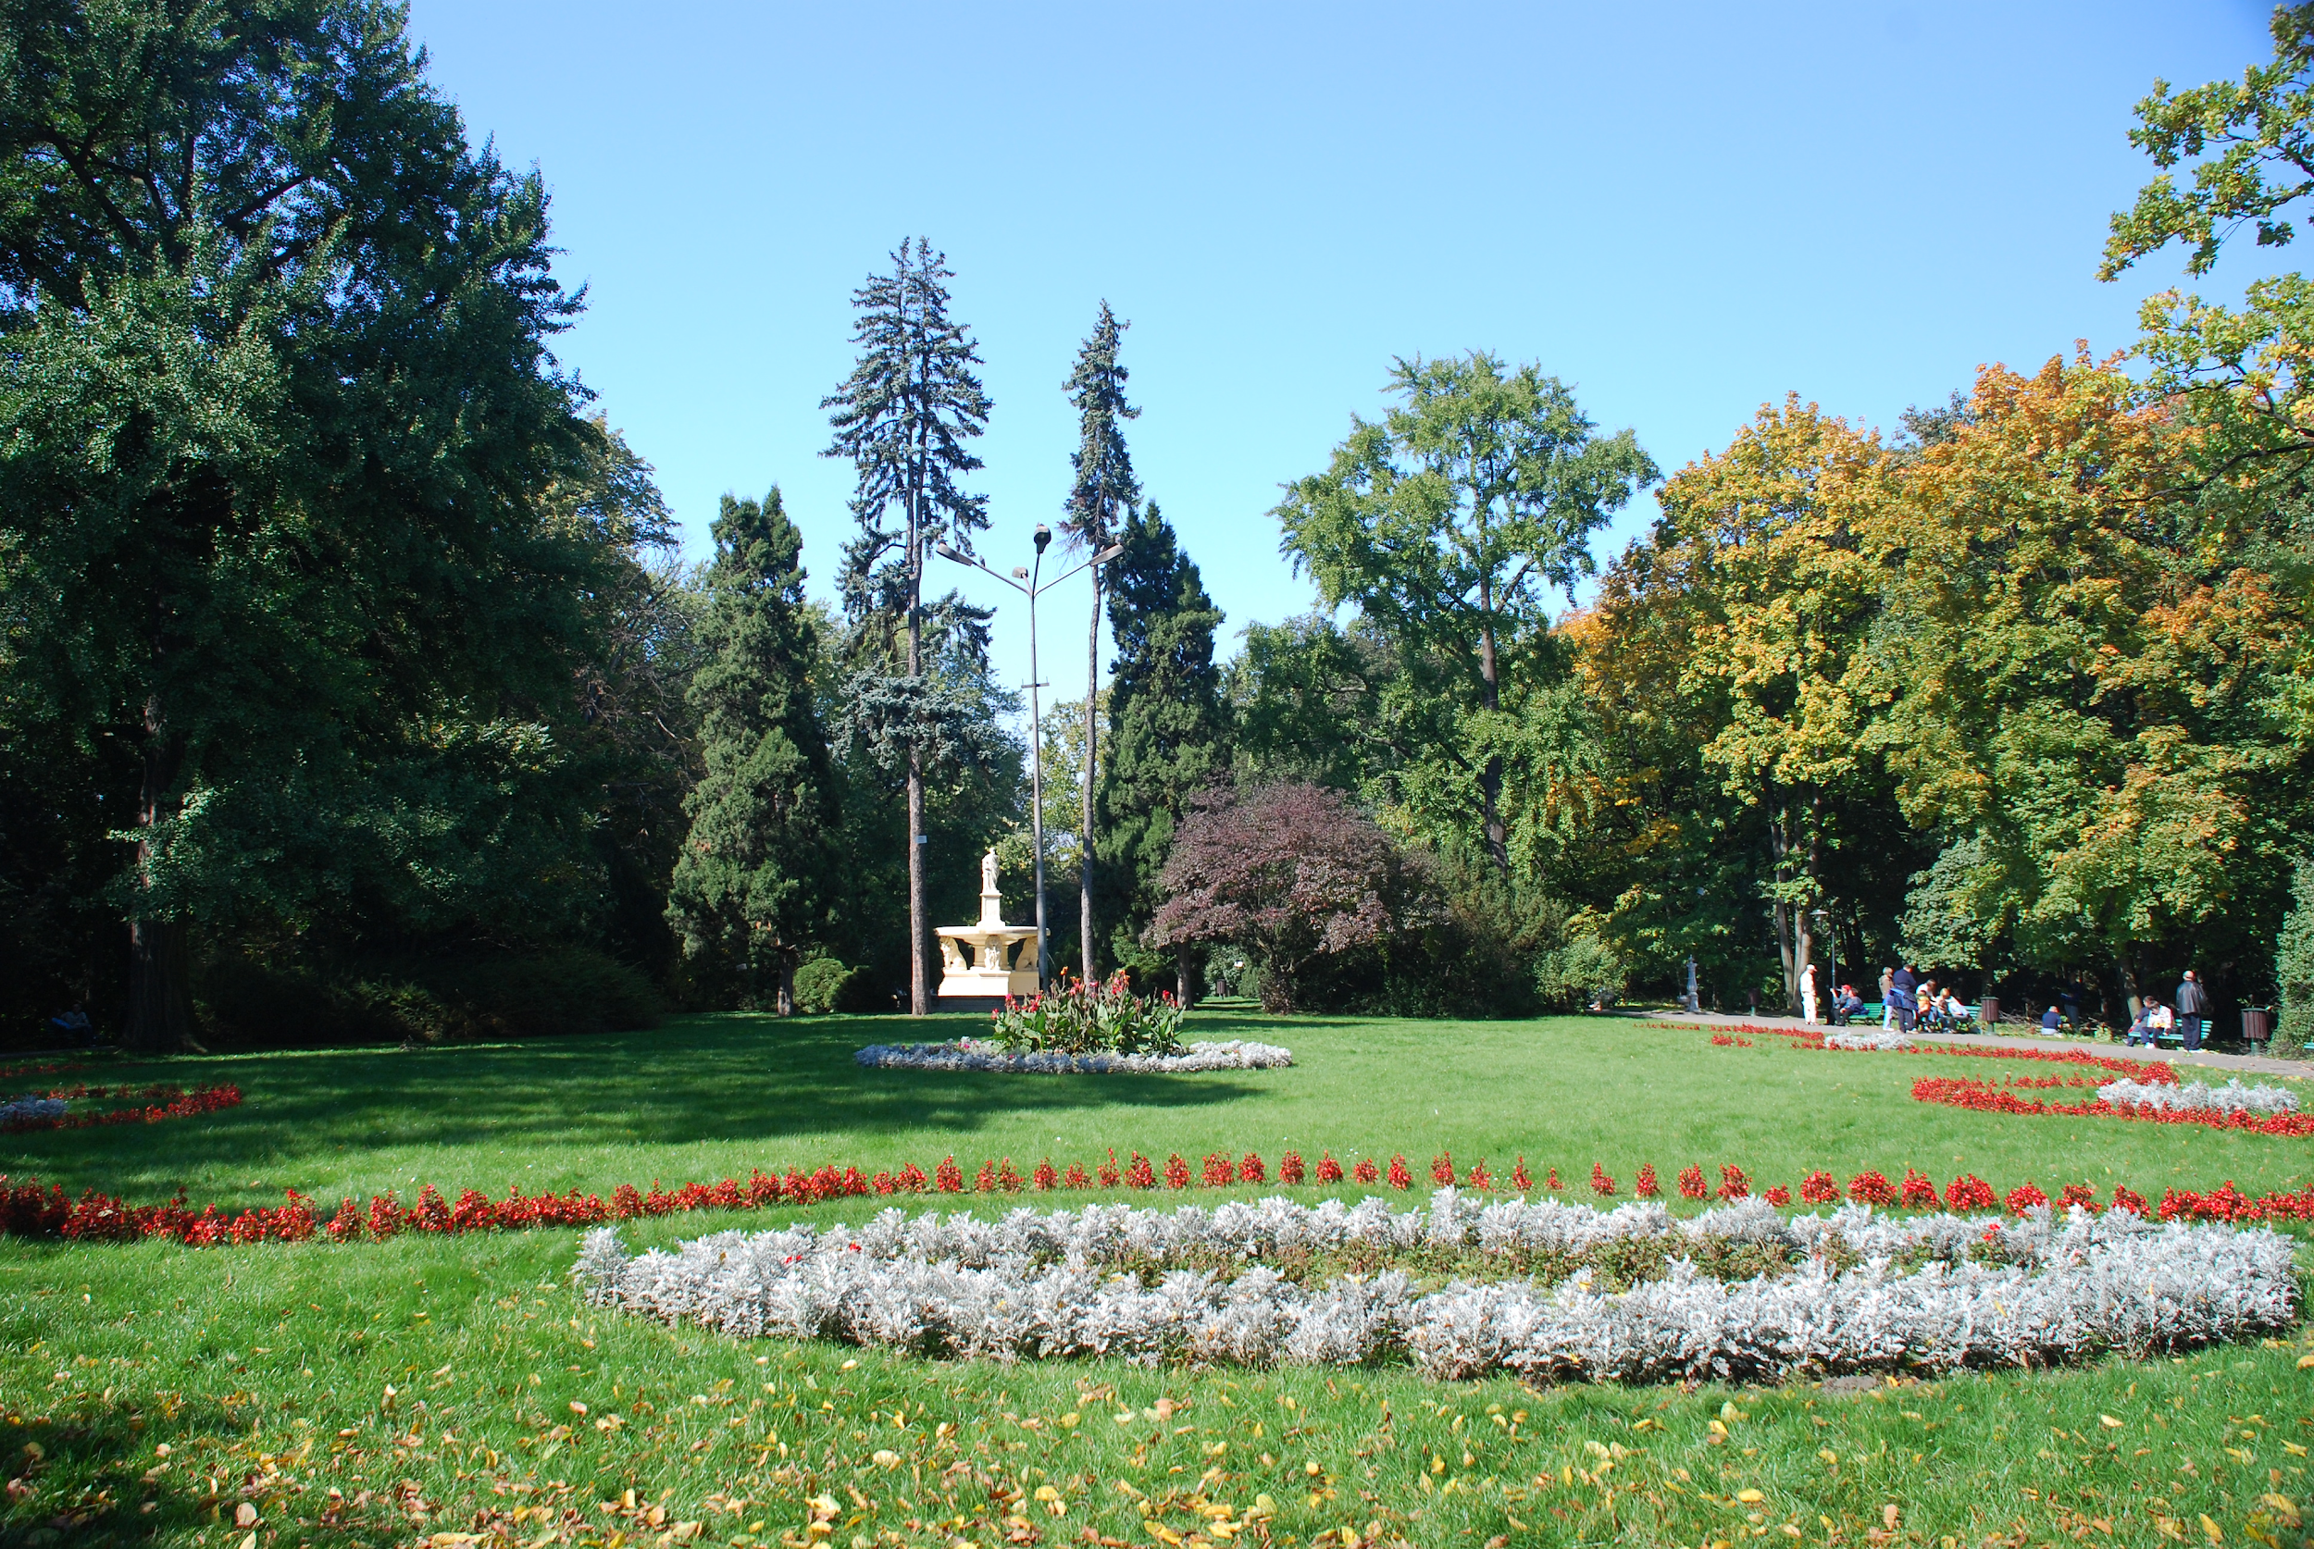
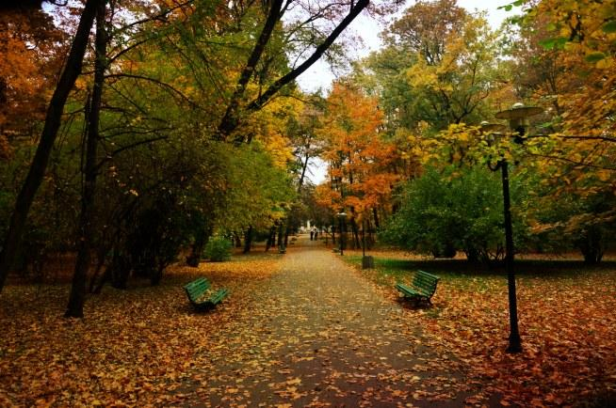
park strzelecki in Tarnów
Strzelecki Park is a urban park in Tarnów, where is the mausoleum of Józef Bem. Also in park is old forest which is a natural monument. there is a educational path with stops at the most interesting plants.

Slide 3
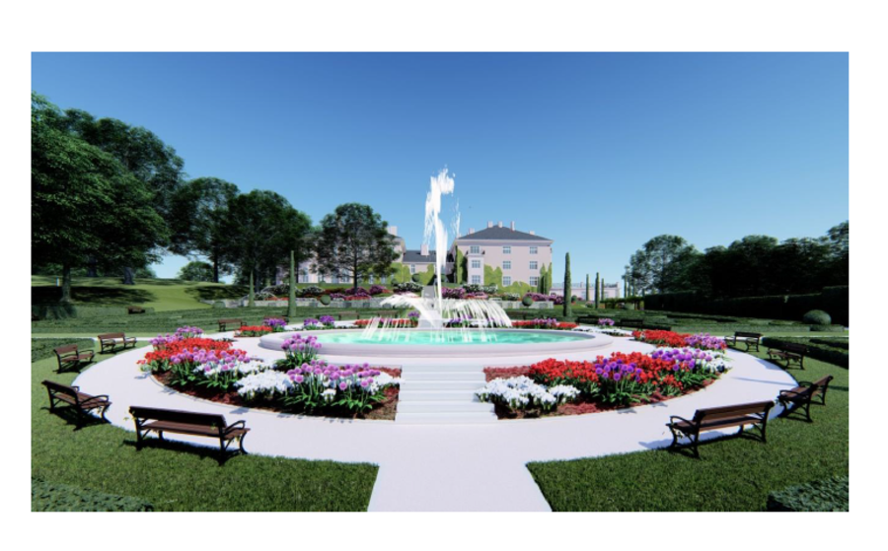
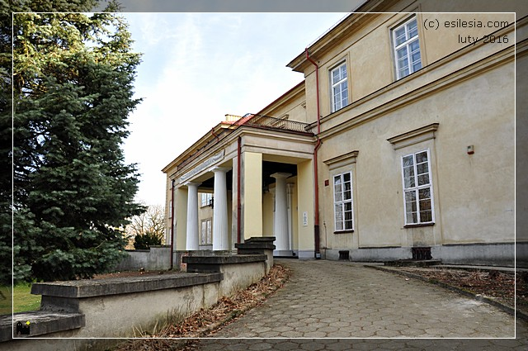
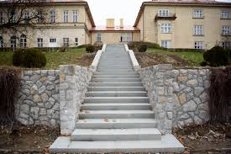
park sanguszków
Sanguszko is a park where was residence of the Sanguszko magnates, the last owners of Tarnów, located in the Gumniska. In the park there are also a granary and two administrative buildings. The seat of the School of Economics and Horticulture in Tarnów

Slide 4
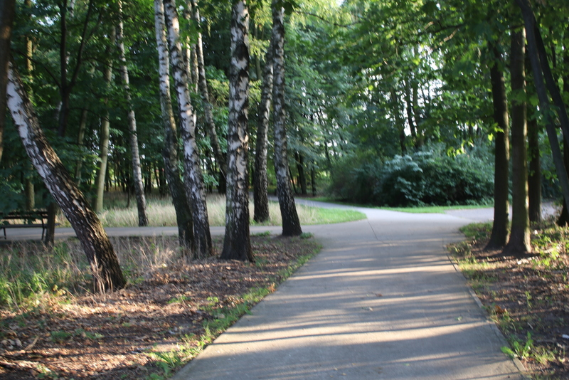
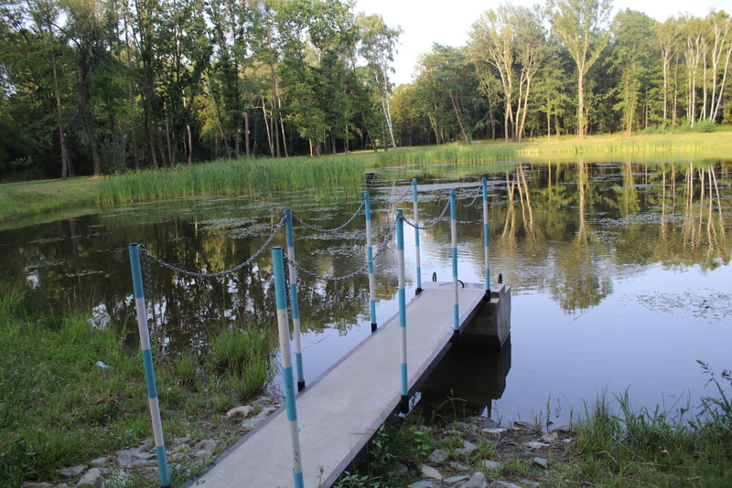
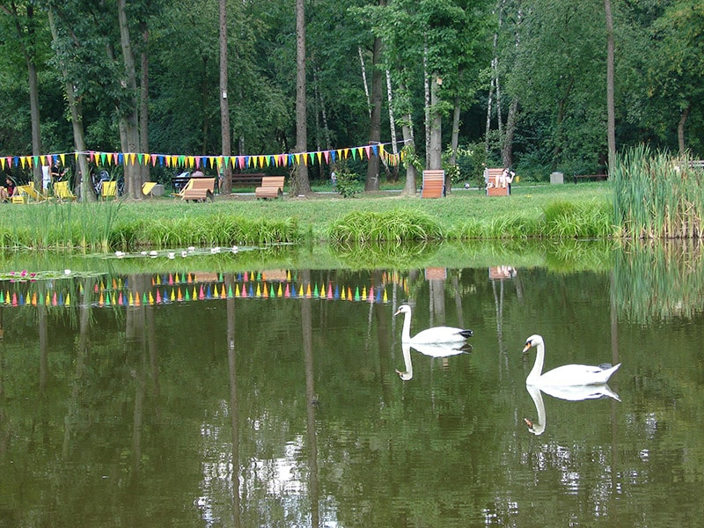
park Piaskówka
The park in Piaskówka was established in the years70. It was built on the site of a former sand mine. Now there plant many species of trees. Among the newly planted trees, gravel paths and benches appeared, and a mini-buffet and a small concert stage.

Slide 5
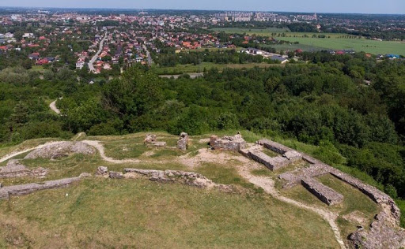
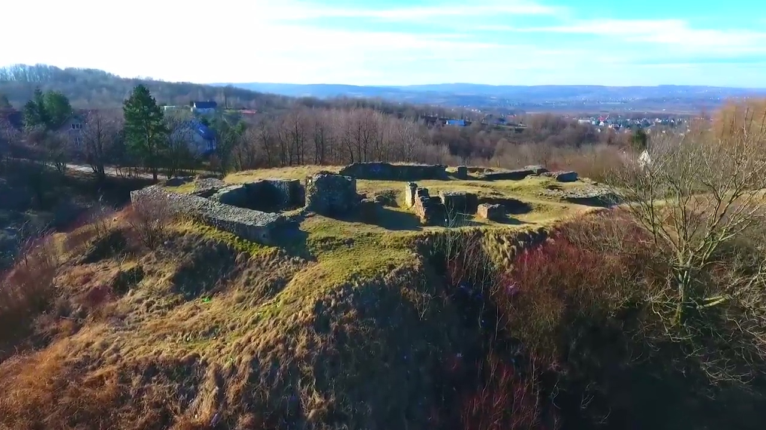
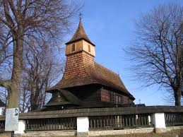
Saint Marcin Mountain
The name of the mountain (popularly known as Marcinka) comes from the historic church of St. Martin in village of Zawada, which is the oldest church in Tarnów

Slide 6
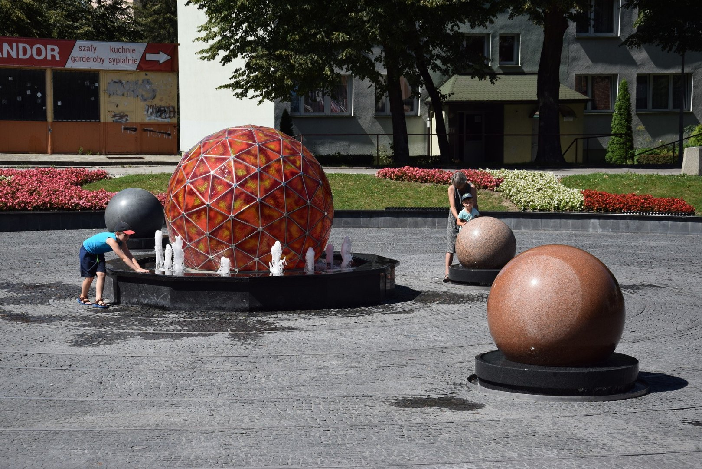
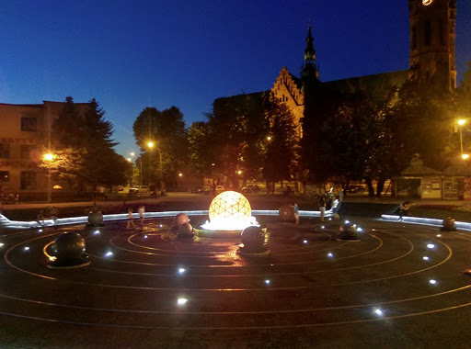
solar system - waterfall
The fountain has 28 meters in diameter and it seems to be a solar system. In the center is representing the Sun, made by steel and glass and light inside. The planets rotate around their own axis

Slide 7
thank you for your attention

